Slide 1
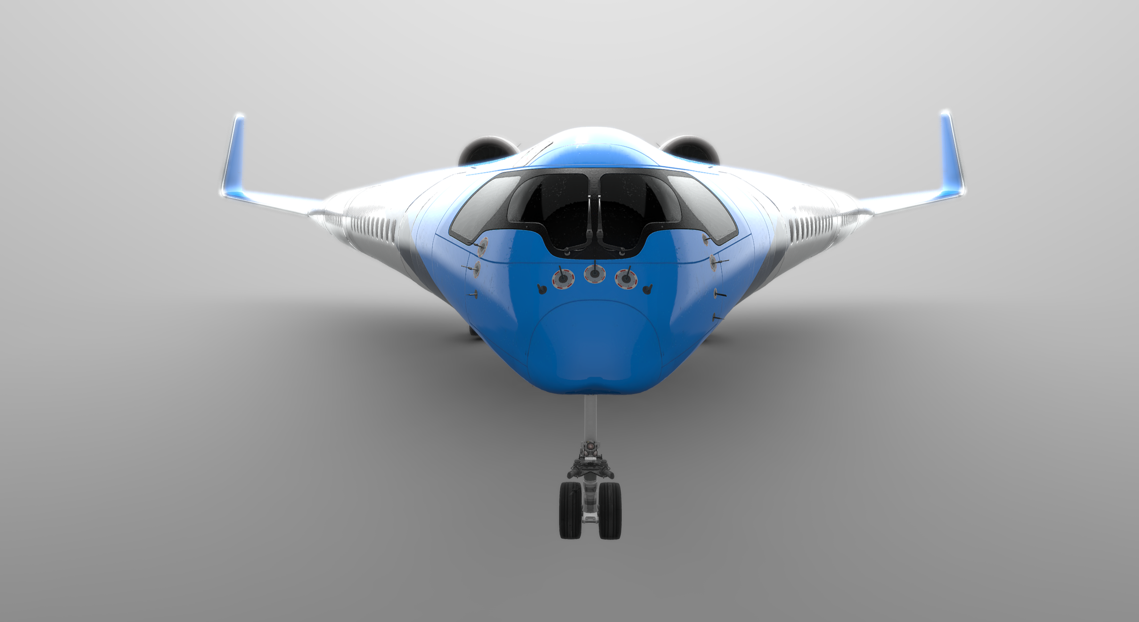
Design of a Flying V Subsonic Transport
Date and Place of the Event
Date and Place of the Event
Flying V: A Disruptive Airplane Configuration
Roelof Vos, PhDAE, AFAIAA
Assistant Professor, Faculty of Aerospace Engineering
Roelof Vos (r.vos@tudelft.nl), Assistant Professor, Faculty of Aerospace Engineering, TU Delft
Notes:
Slide 1

Slide 2
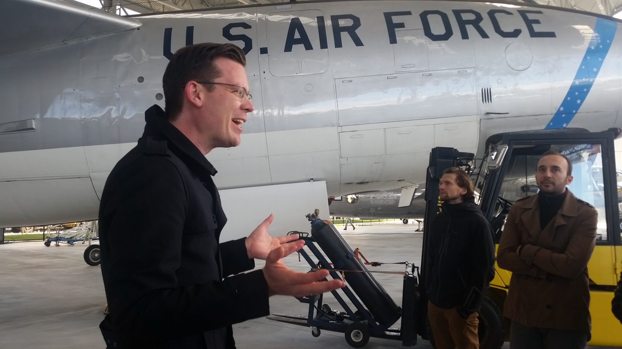

Slide 3
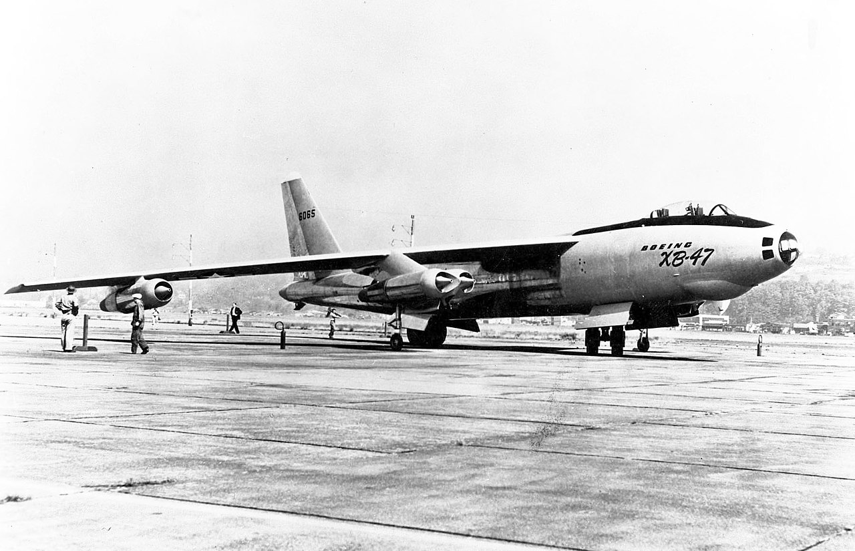

Slide 4
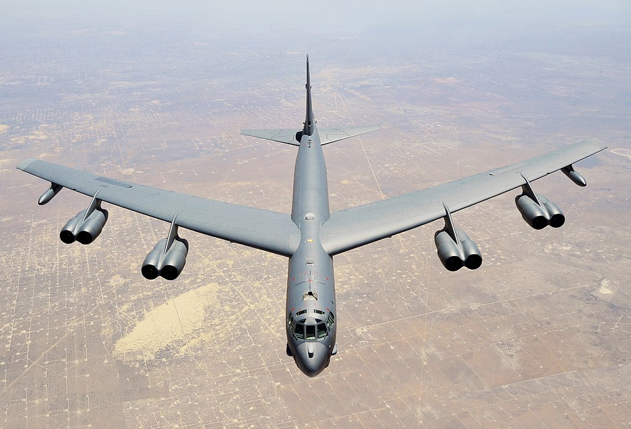

Slide 5
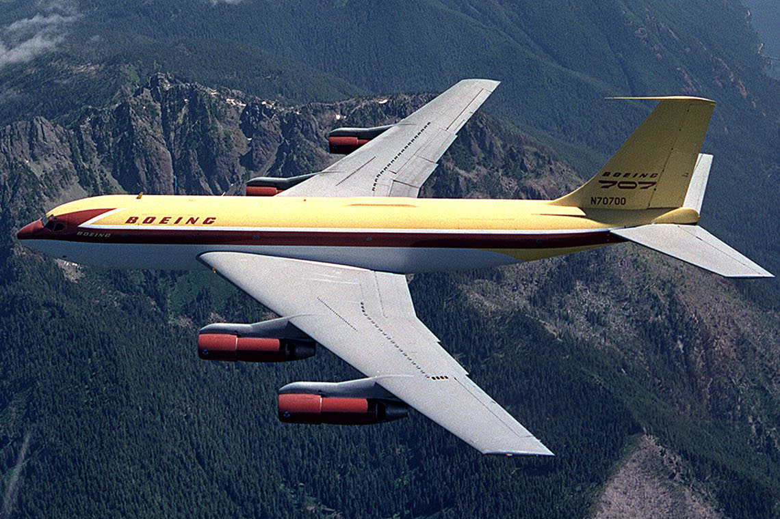

Slide 6
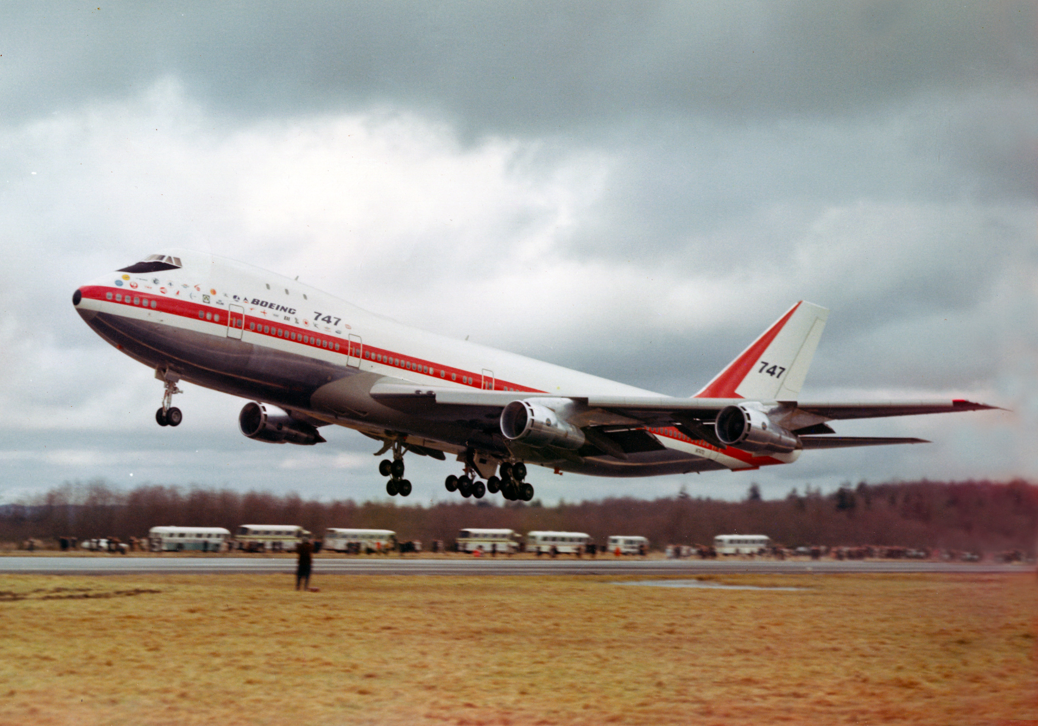

Slide 7
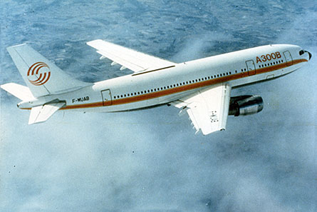
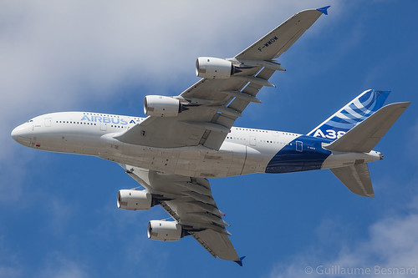
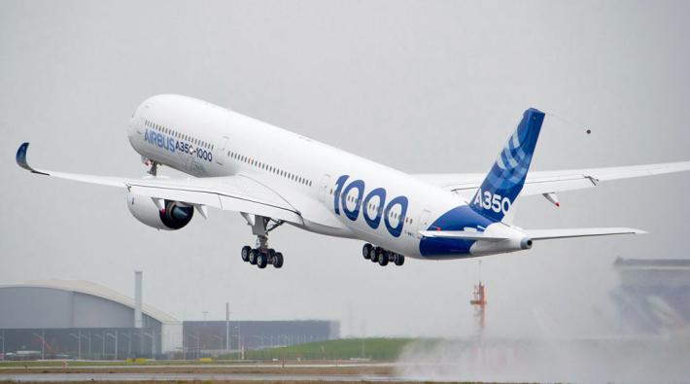
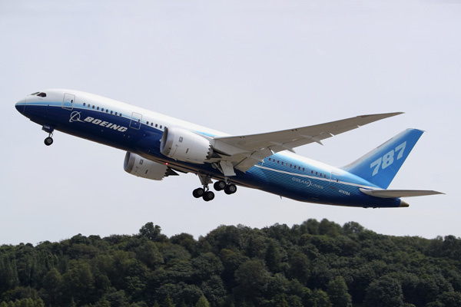
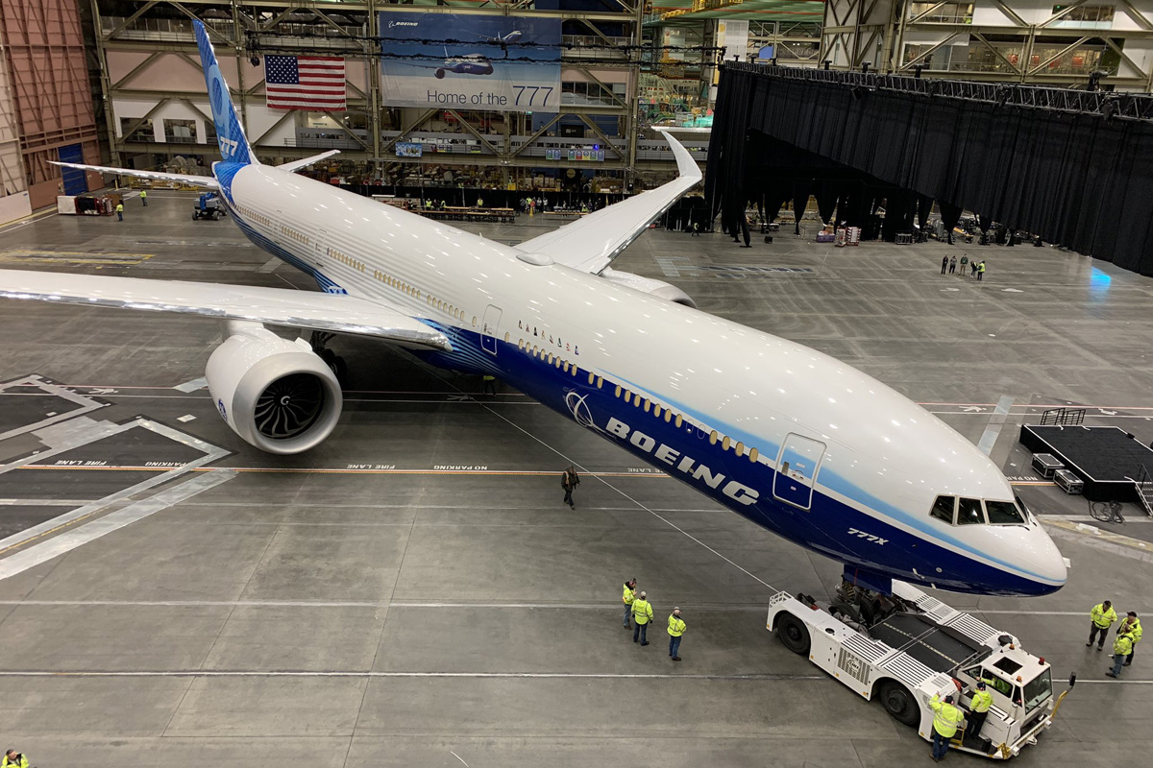
The rest is history…

Slide 8
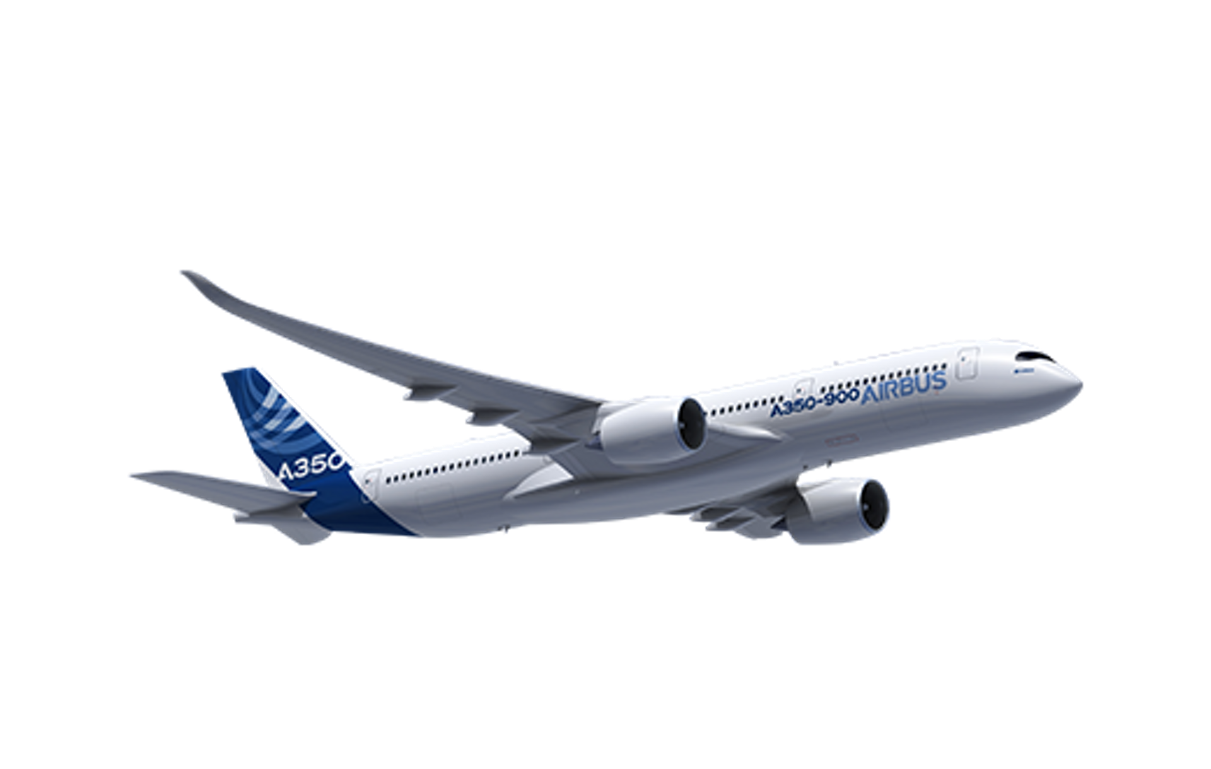
The Problem: Aviation’s Contribution to Global Warming
43% of emissions from wide-body aircraft
Notes:
ICCT CO2 emissions from global aviation (2020)

Slide 9
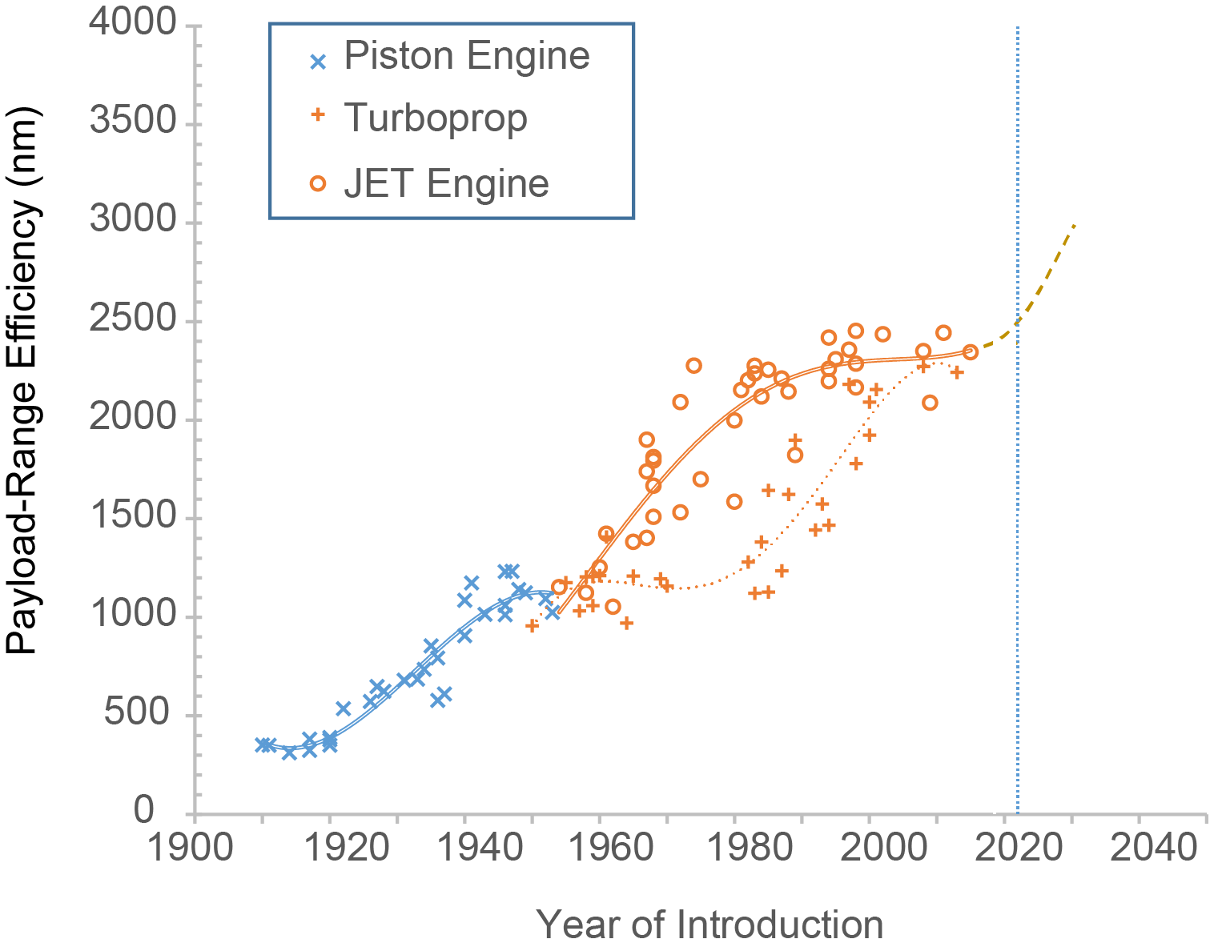
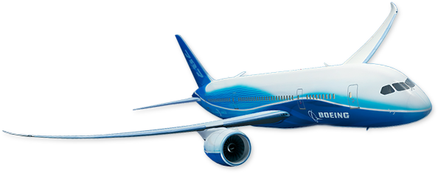
The Problem: Tube-and-Wing Aircraft Fully Mature
New technologies are required to improve efficiency
Tube-and-wing aircraft are at a plateau in terms of their efficiency growth with time
Mo, L., “Conceptual Design Study for In-flight Refueling of Passenger Aircraft”, PhD thesis, TU Delft, 2017

Slide 10
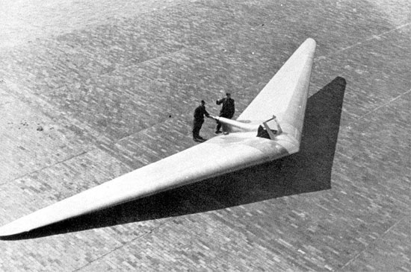
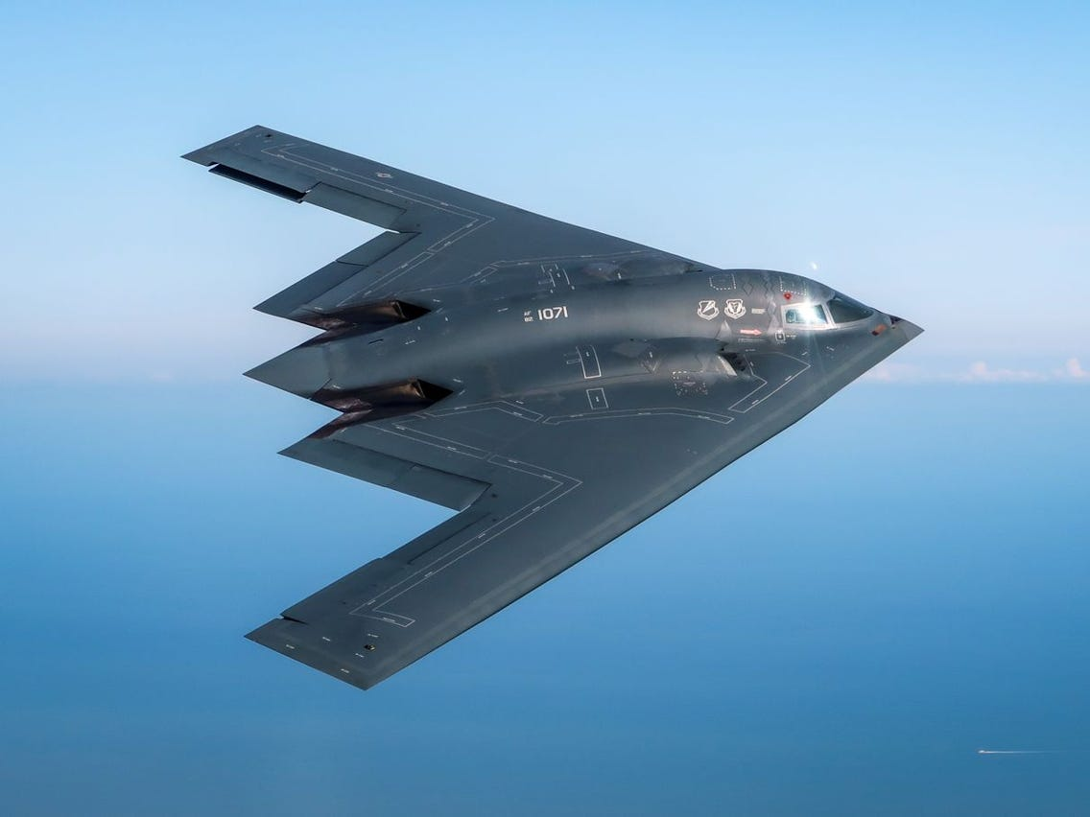
What about Flying Wings?

Slide 11
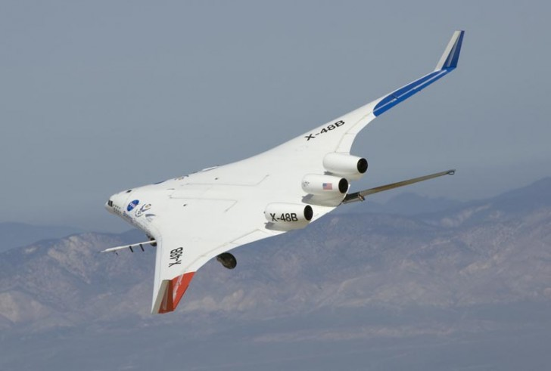
Boeing/NASA Blended-Wing Body
Notes:
+ Lower wetted-area to volume ratio → less friction drag
+ Lift is generated at the same location as the weight → reduced weight
+ winglets double as vertical tails → reduced lift-induced drag
+ Improved area ruling
Pressurized cabin requires complicated and costly composite manufacturing techniques
The T-plugs are difficult to integrate to make a family

Slide 12
Introducing the Flying V

Slide 13
Flying V Overview
Complementary to propulsion innovations
Winglets
Control surfaces
20% less energy consumption
Stretchable wing
290-365 passengers
Oval pressure cabin
Notes:
Slide 27
[MV] fuslelage = fuselage?
SFC = specific fuel consumption
L/D increase based on L/D of 23 of the flying V over an L/D of 20 of the A350.
Airplane fits in the same gate as the A350.
Main question: how heavy will it be. This is still to be answered.

Slide 14
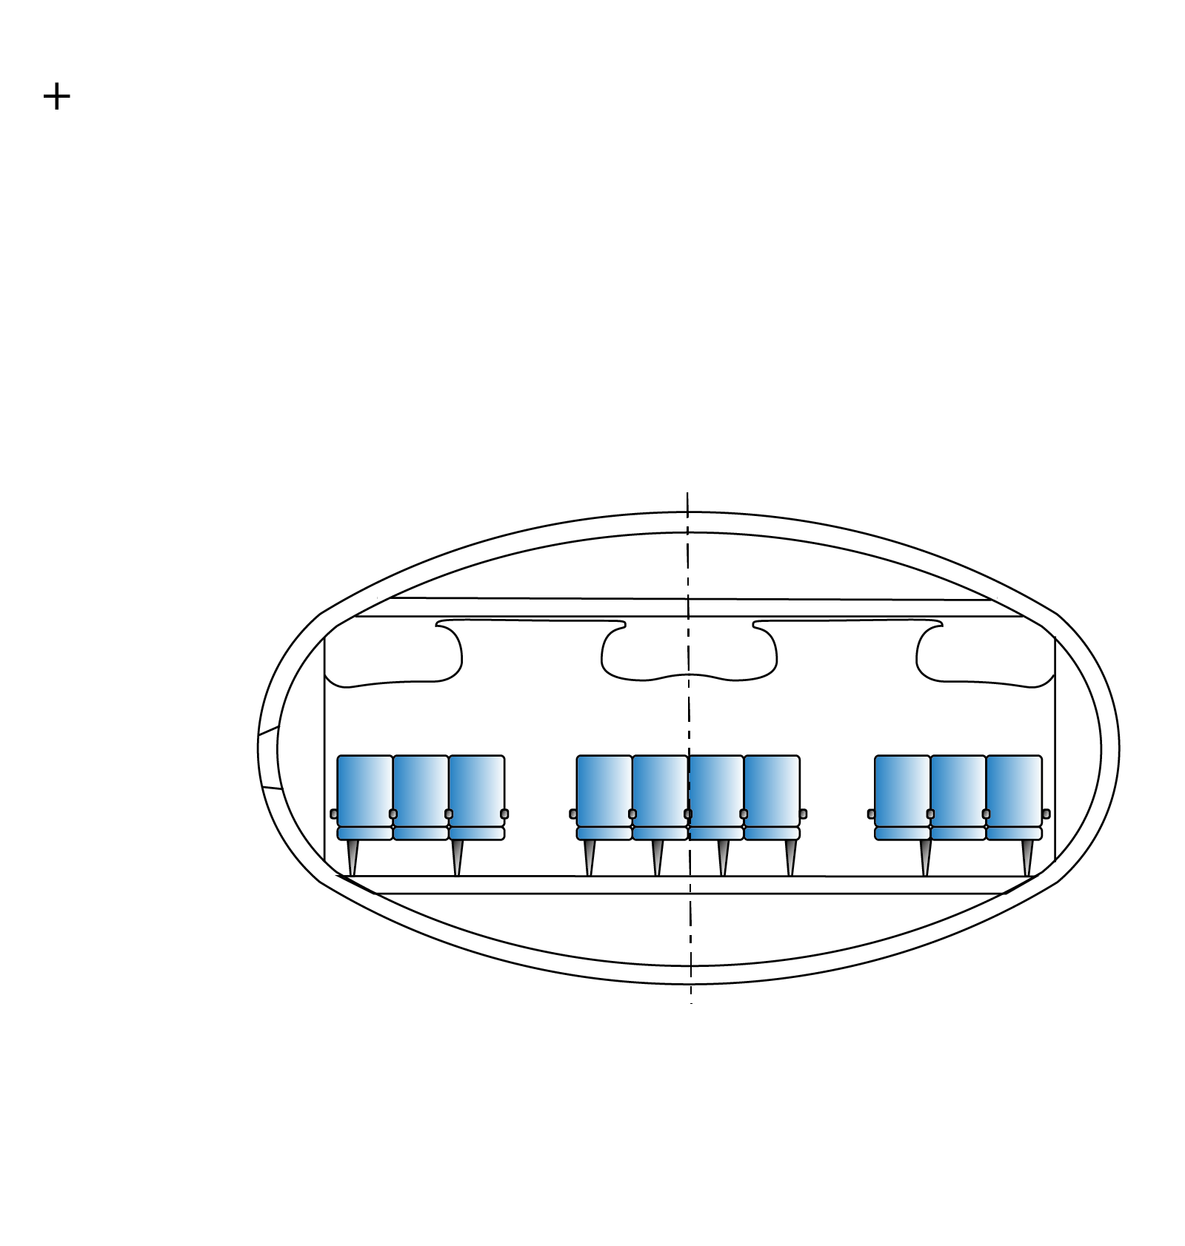
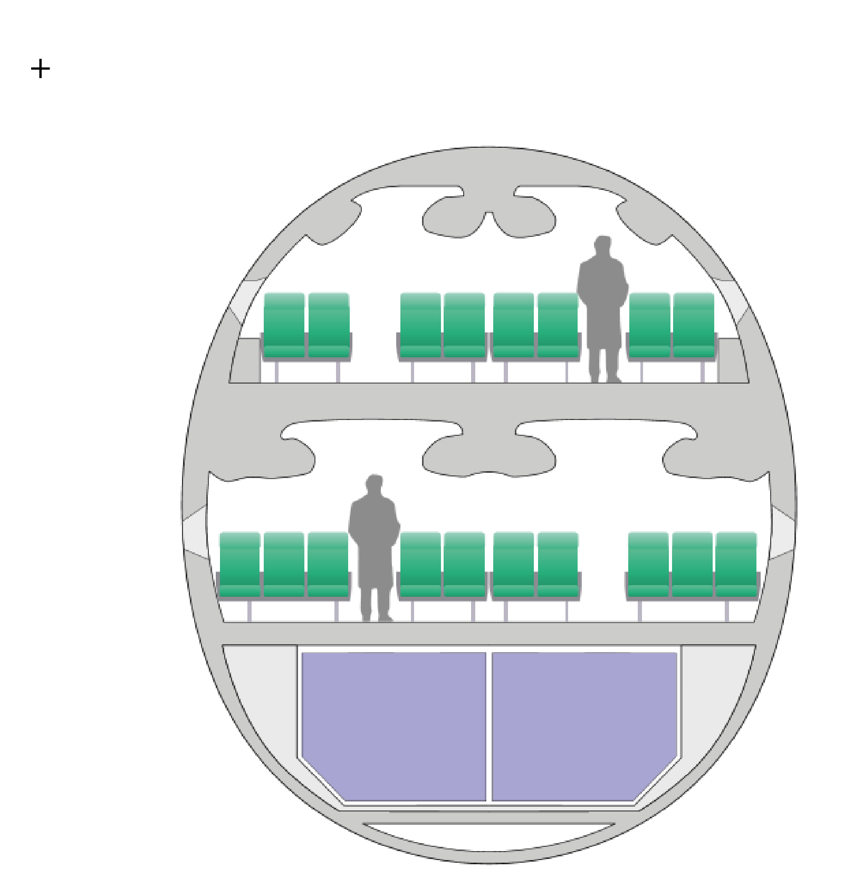
Design of the Cross Section
Notes:
Slide 18
[MV] consequent in klassiek (Airbus) rechts en Flying V links?

Slide 15
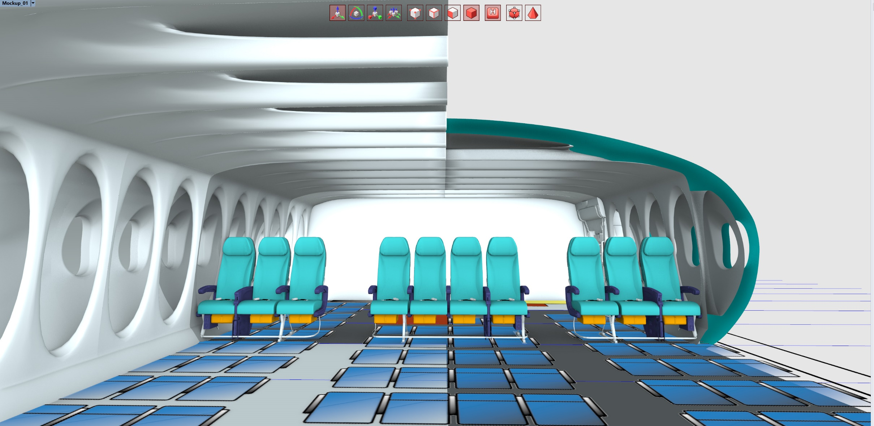
Design of the Cross Section
Design: Studio OSO
Notes:
Slide 19

Slide 16
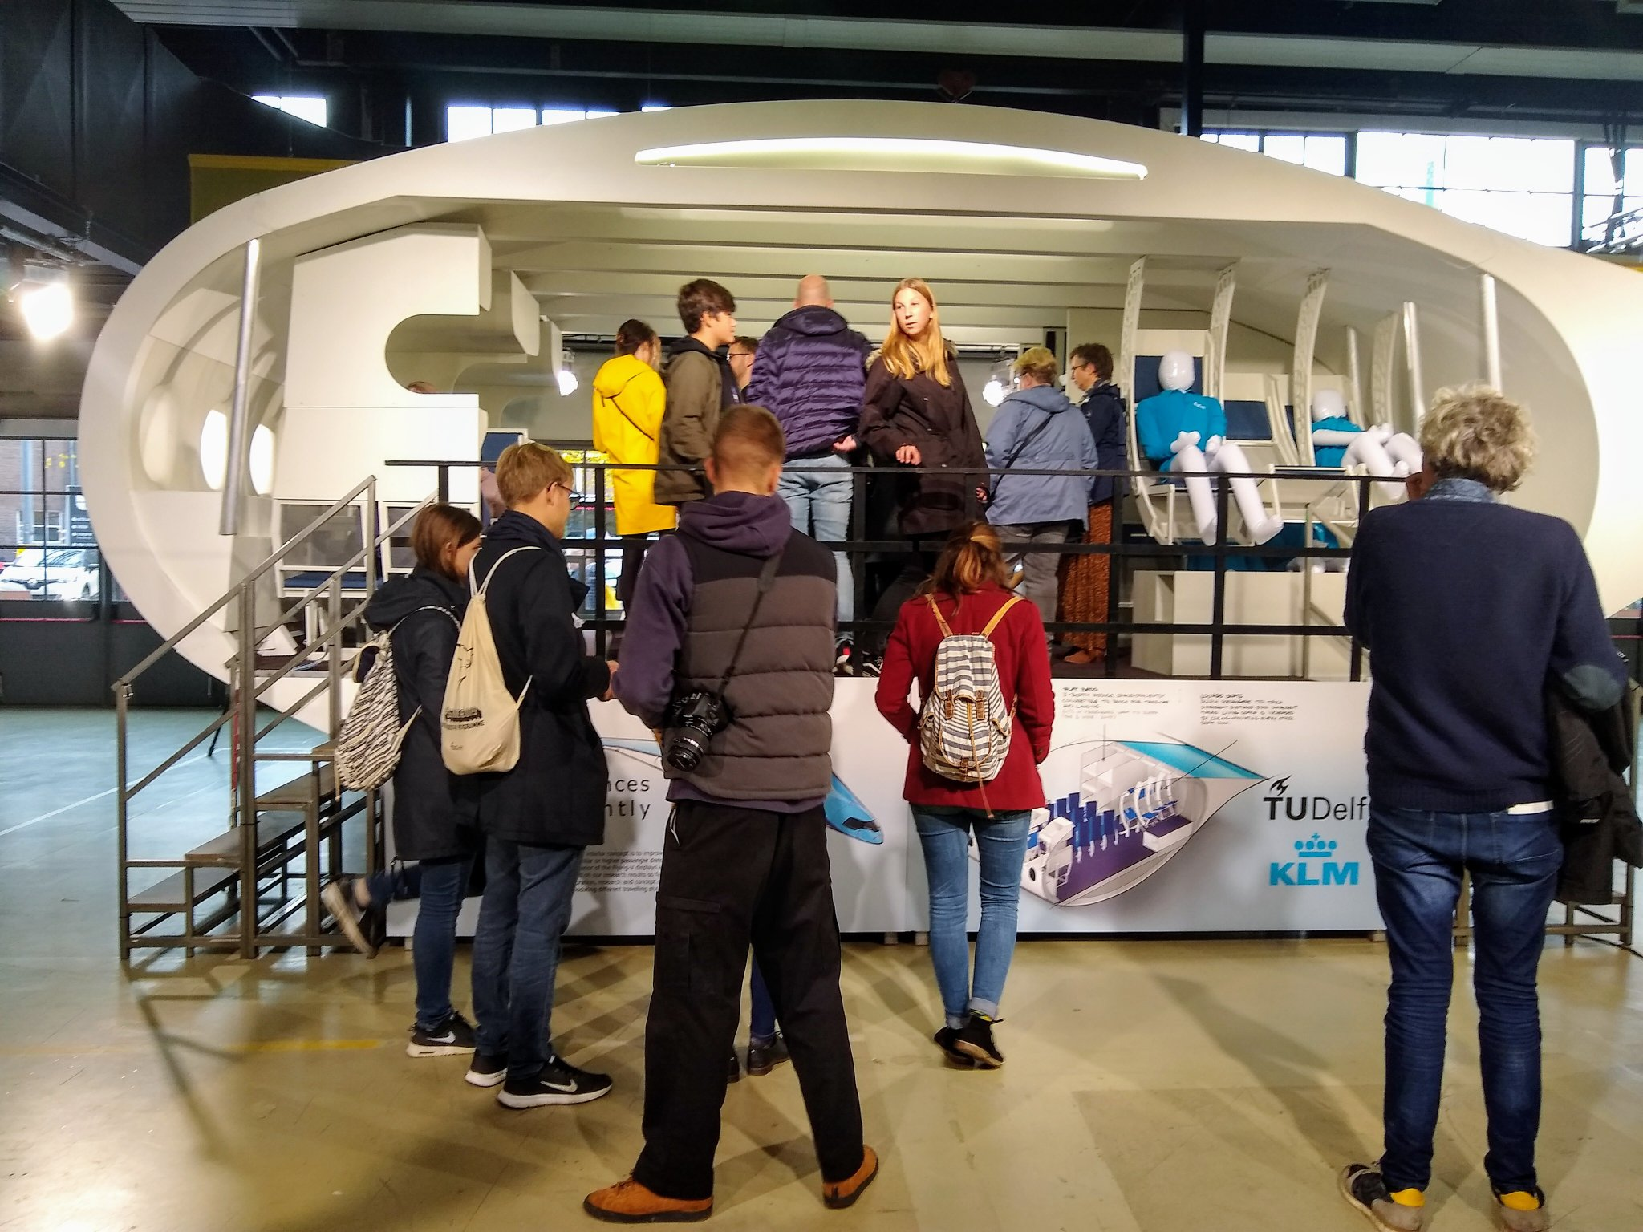

Slide 17
Cabin Analysis
A350-1000
FV-1000
Pax = 369
Floor area = 314m²
Pax = 368
Floor area = 334m²
1.18 pax/m²
1.10 pax/m²
Flying V has 6% less passengers per unit floor area (!)

Slide 18
Family Concept
FV-800
293 seats
10 LD9 containers
FV-900
328 seats
14 LD9 containers
FV-1000
368 seats
18 LD9 containers
Notes:
Slide 24
[MV] kleine tekst en onderdelen afgeschermd
[MV] per stap in animeren?

Slide 19
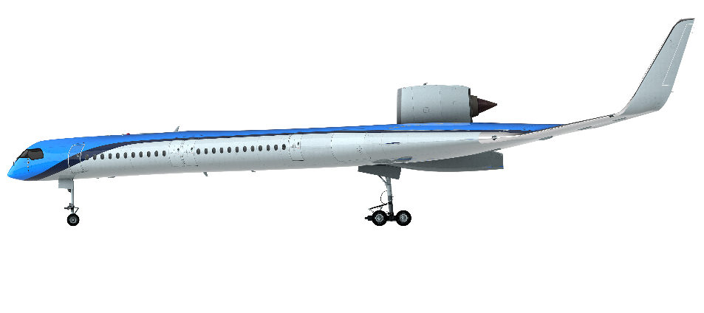
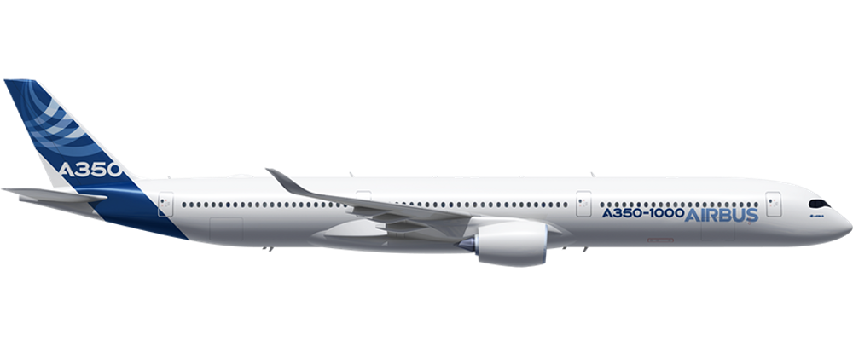
Payload-Range Efficiency
Flying-V-1000
2990 nm
+2% due to 750km reduction in harmonic range
2940 nm
+6% due to 8% decrease in structural weight
20% PRE increase
2790 nm
+10% due to 6% increase in effective span
A350-1000
2540 nm
2510 nm
+3% due to 5% reduction in wetted area
-1% due to reduced design payload weight
2490 nm
Notes:
Assumed design range A350-1000: 15030km
Assumed design payload A350-1000: 37270 kg (369 pax*101kg/pax)
Design range FV-1000: 15230km
Design payload FV-1000: 36865 kg (365 pax *101kg/pax)
Passenger weight incl. baggage= 95 kg, operational items per passenger (i.e. food+water) = 6kg

Slide 20
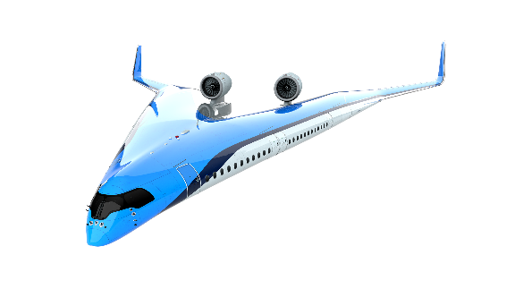
B787
asymptote
A350
Mo, L., “Conceptual Design Study for In-flight Refueling of Passenger Aircraft”, PhD thesis, TU Delft, 2017
Notes:
Slide 4
[MV] pijlen voor Past/Future nodig?

Slide 21
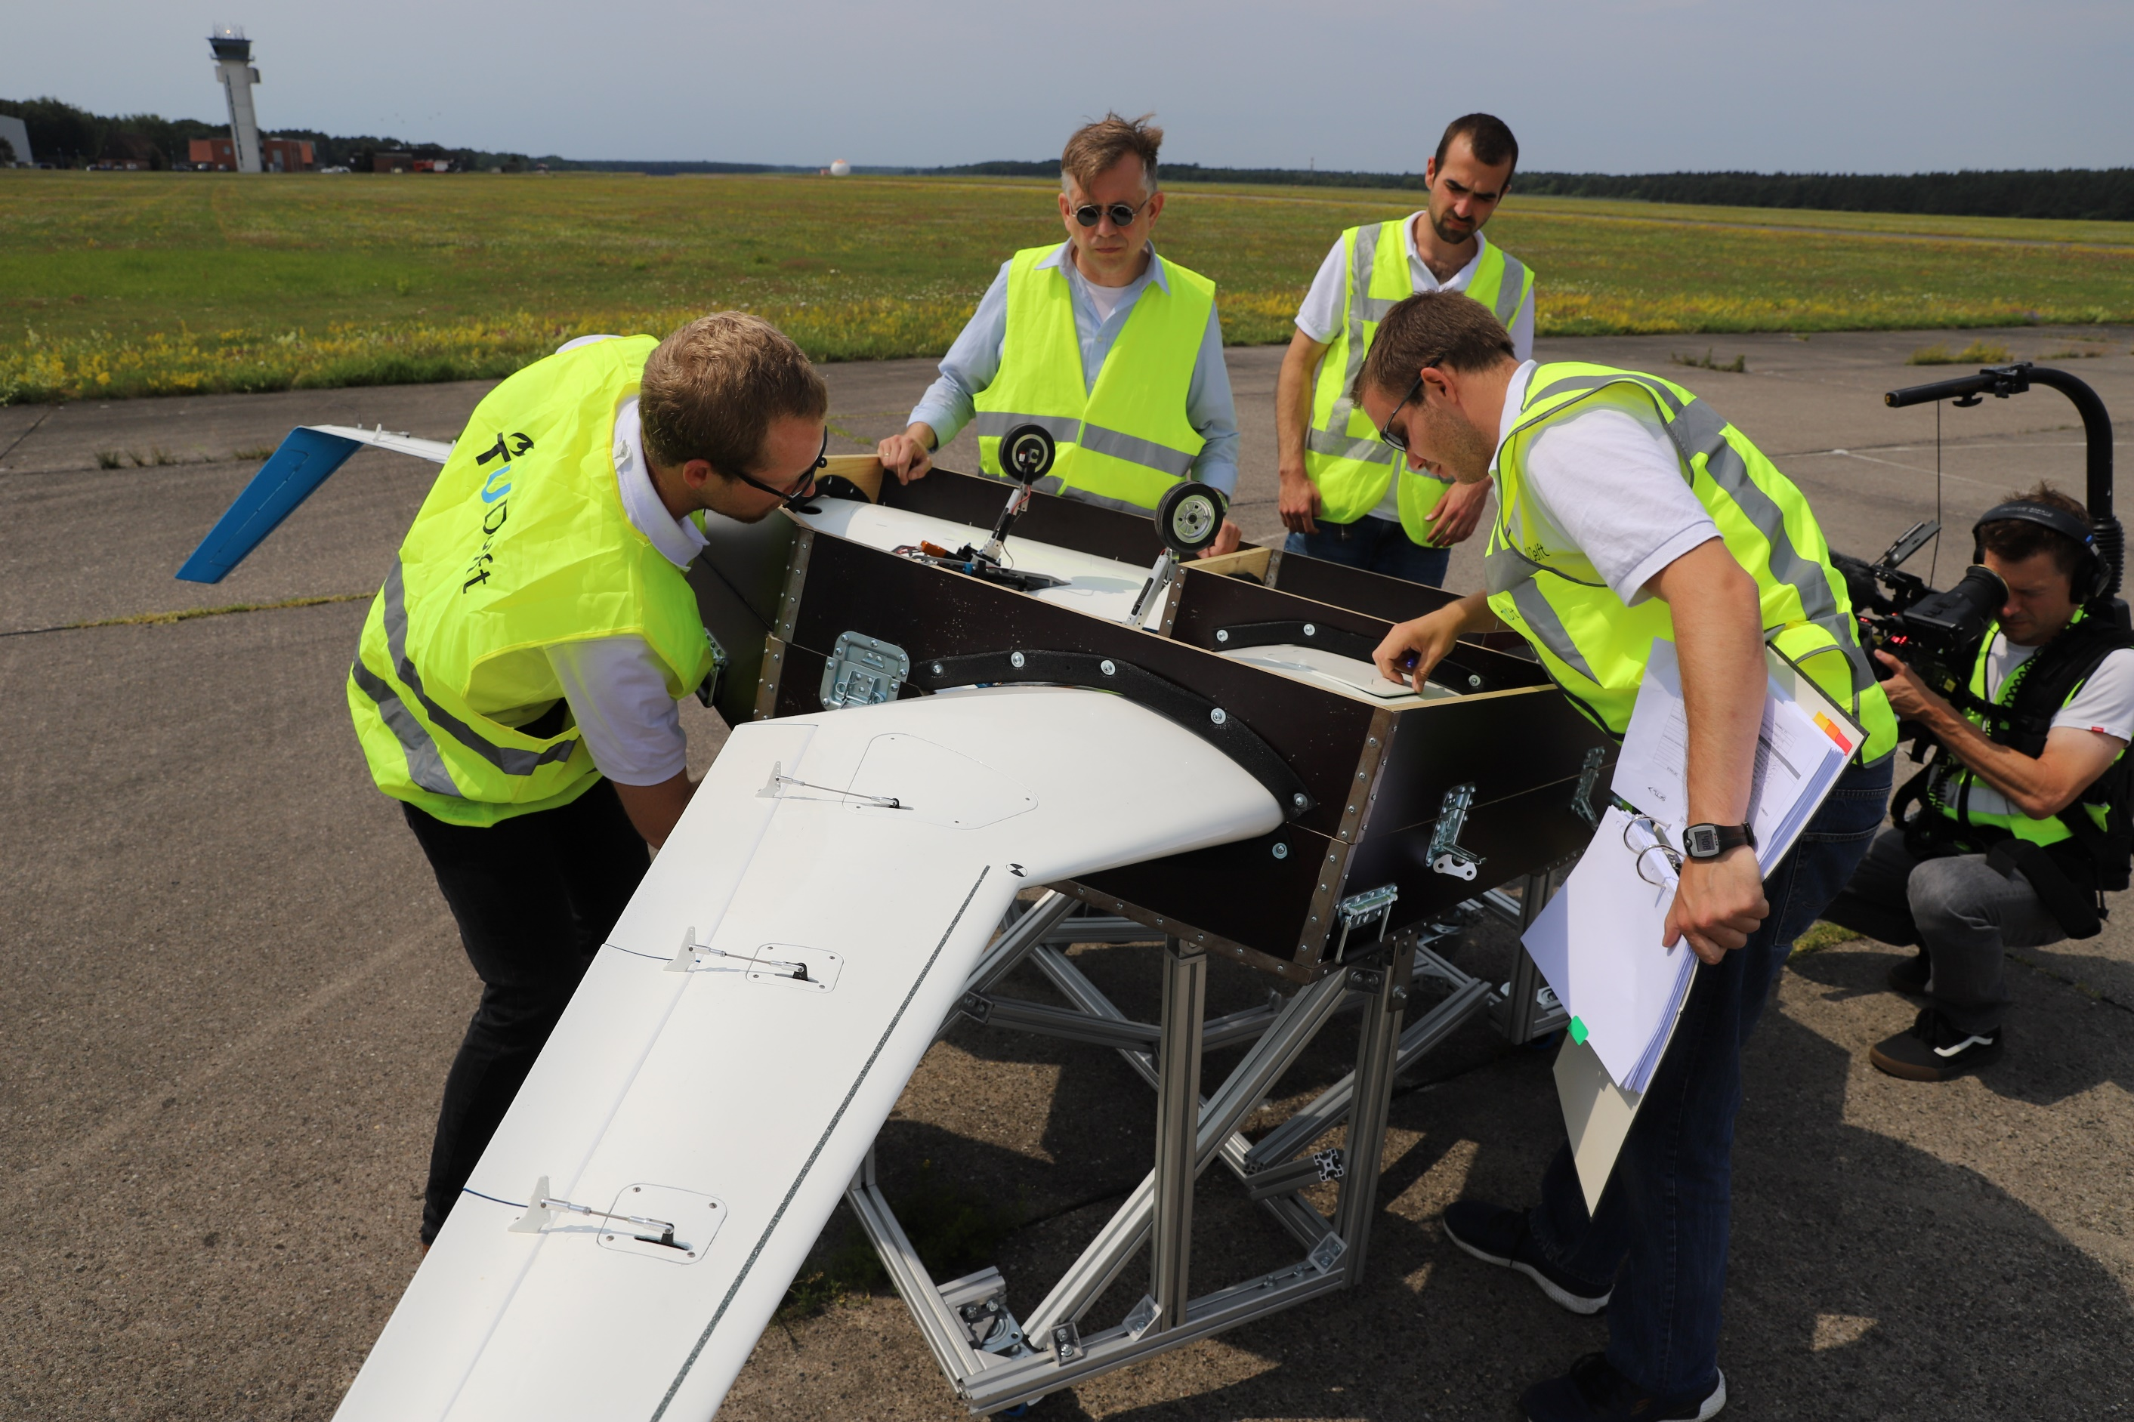
Can it Fly?

Slide 22
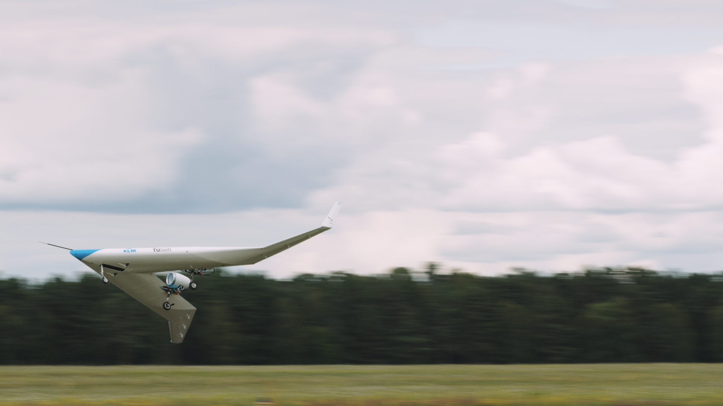
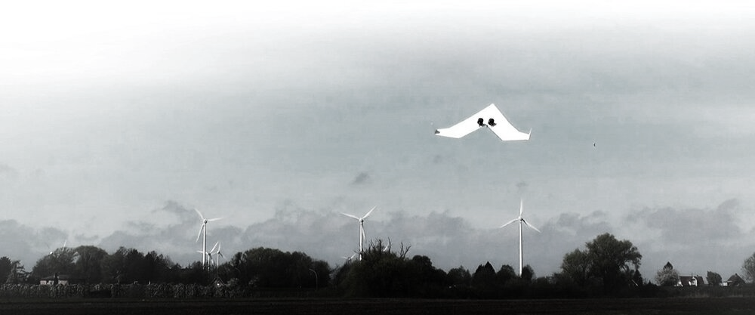
Yes it Can!

Slide 23
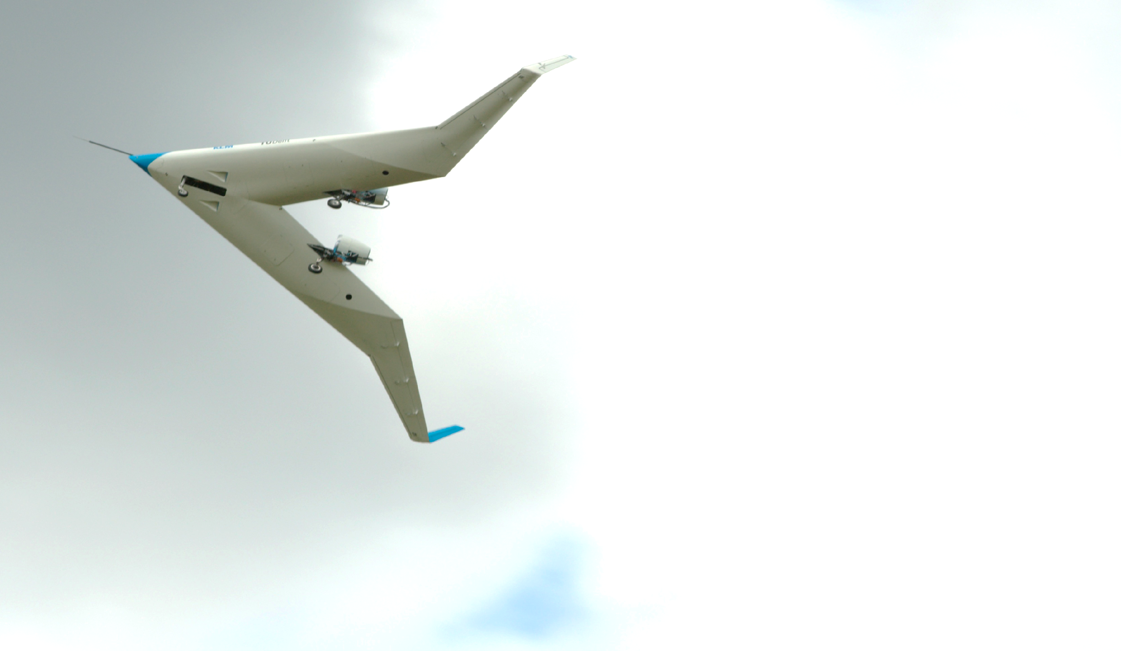
Pioneering Spirit back to Europe!
Flying V versus Tube-and-Wing:
Lower structural weight
Higher aerodynamic efficiency
No flaps
Simple family concept
Adequate handling qualities
Flying V has the potential to disrupt aviation industry

Slide 24
tudelft.nl/flying-v
linkedin.com/in/roelofvos
Notes:
Slide 27
[MV] fuslelage = fuselage?
SFC = specific fuel consumption
L/D increase based on L/D of 23 of the flying V over an L/D of 20 of the A350.
Airplane fits in the same gate as the A350.
Main question: how heavy will it be. This is still to be answered.

Slide 25
Collaborative Research
Notes:
Slide 28

