Slide 1
Online Meeting NAG Young Talent Network
March 25th, 2021

Slide 2
Program:
15:00 Introduction by Frank Jansen, Managing Director at the NAG, afterwards Bas de Glopper, Project Manager at KLM E&M, takes over the role as event host.
15:15 Presentation 1: Roelof Vos, Assistant Professor Tu Delft.
15:45 Presentation 2: Jan-Willem van Zwieten, Team Manager Aerodelft.
16:15 Networking via Remo.
16:30 End of program.

Slide 3
Introduction
Short intro NAG
Current situation
NAG motivation for Young Talent Network

Slide 4
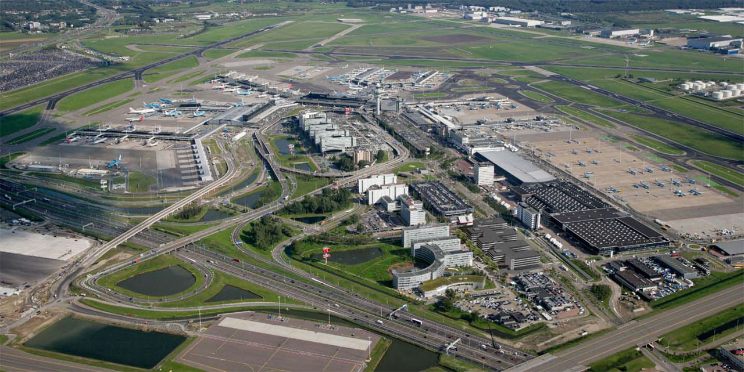
The Dutch aerospace and airport industry is active in all services and products:
Aircraft Manufacturing
Aircraft Maintenance
Airport Development & Infrastructure
Services
Association for knowledge, network and business opportunities.
2021: + education⬄industry
Notes:
Our members:
100+ members, covering 95% of the total Dutch aviation industry turnover ​
Members characteristics: ​
Education and training: all levels​
Research Centers​
Manufacturing Industry​
MRO Industry (+GSE) ​
Logistics​
Consultancy​
Airport Suppliers​
ATM technologies and services​
Members expect better network and market opportunities
Located in Delft between 140 start-up companies in Yes!Delft, one of the fastest growing/most dynamic environments for entrepreneurship. This for innovation in aviation.

Slide 5
Current situation
What next?
Reshape sector
Sustainability
UAM
Workforce age structure
Shortage

Slide 6
NAG motivation for YTN
Building the future
Stimulate professional development
More cohesion in the sector
Attract talent
We like to work with you

