Slide 1
Overview of aerospace market and trends
03-06-2025
Results from NCBP study for MEAC and NAG
Jan Verbeek

Slide 2

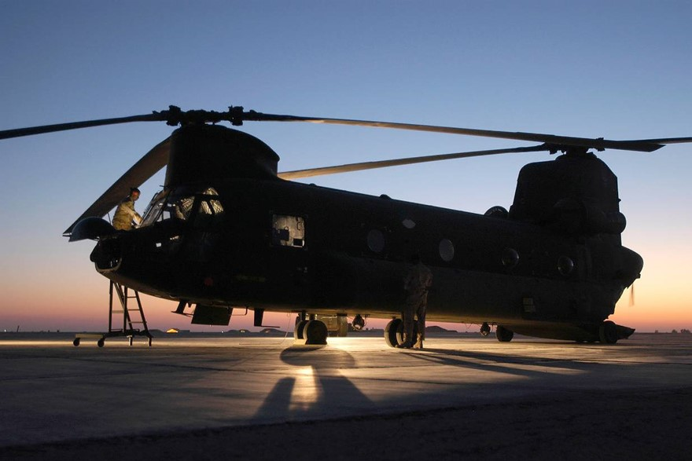
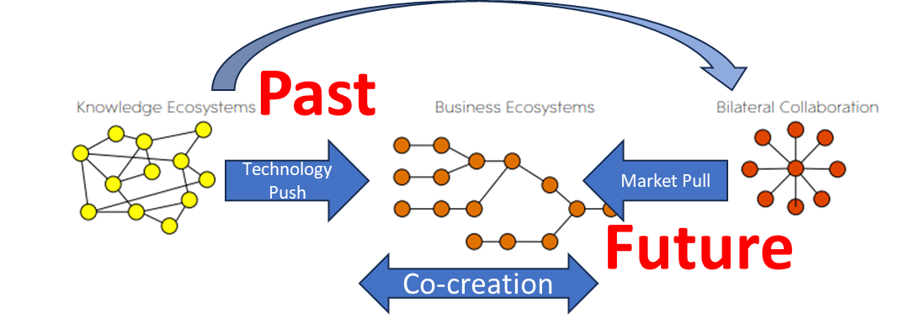




Content
Introduction
Overview of aerospace industry characteristics
Netherlands industry position
Market analysis – large commercial
NL opportunities & threats, strengths & weaknesses
Next steps

Slide 3






ADSE BV | Company Introduction
Company Overview
An independent Netherlands-based engineering consulting firm
TRANSPORTATION SYSTEMS OF TODAY AND TOMORROW
SUSTAINABILITY | AUTONOMOUS OPERATIONS | DIGITIZATION
WE LOVE TRANSPORT!
Hoofddorp
The Netherlands
INDUSTRIES SERVED
AEROSPACE
RAIL
MARITIME
DEFENCE
1996 ESTABLISHED
75+ HIGHLY SKILLED PROFESSIONALS
WORLDWIDE
CUSTOMER BASE
EASA DOA.21J.481
MAA-NLD-A-21-018
FACTS & FIGURES
CORE SERVICES
ENGINEERING
CERTIFICATION & COMPLIANCE
TECHNICAL PROJECT MANAGEMENT
CONSULTING

Slide 4
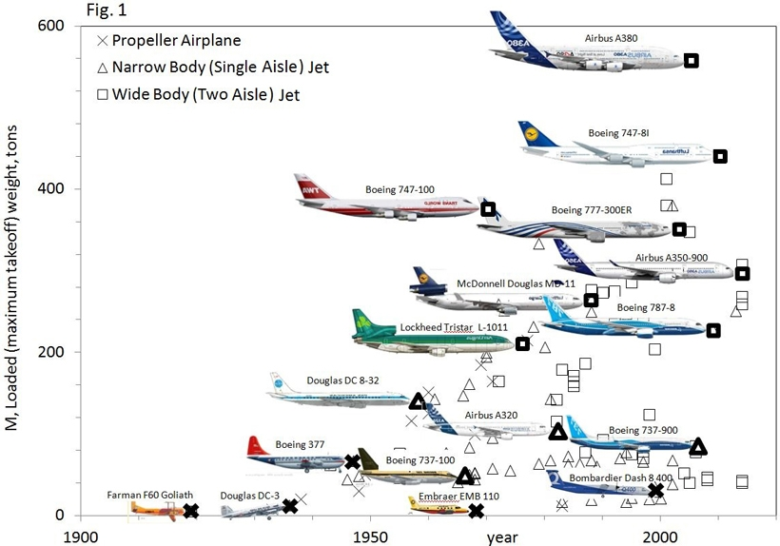
Aviation has evolved from a technology to a commercial driven business
Aircraft have evolved greatly since the early days
From capability-driven to commercial-driven
History:
Early Development:
Aviation began with the Wright brothers' historic flight in 1903.
Commercialization:
Post-World War I, airlines began offering passenger services.
Golden Age of Aviation (1920s-1940s):
Technological advancements made long-haul flights more common.
Jet Age (1950s-1960s):
Jet engines revolutionized air travel, making it faster and more efficient. Airlines expanded their networks globally.
Hub-and-Spoke Model (1970s-1990s):
Airlines adopted the hub-and-spoke model, where large airports (hubs) served as central connecting points for flights to smaller destinations (spokes).
Low-Cost Carriers (LCCs) and Decentralization (1990s-present):
The rise of LCCs challenged the dominance of traditional carriers. Due to changing consumer preferences, there has been a trend towards decentralization in the aviation network, where smaller airports have gained importance.
Sources: Evolution of Airplanes, https://www.aip.org/publishing/journal-highlights/evolution-airplanes (download: 2-4-2024)
Notes:
Early Development: Aviation began with the Wright brothers' historic flight in 1903. Initially, aviation was limited to experimental flights and military use during World War I.
Commercialization: Post-World War I, airlines began offering passenger services, primarily operating small aircraft on short routes.
Golden Age of Aviation (1920s-1940s): This period saw rapid technological advancements and the establishment of major airlines such as Pan American Airways and British Airways. Long-haul flights became more common, connecting continents and major cities.
Jet Age (1950s-1960s): The introduction of jet engines revolutionized air travel, making it faster and more efficient. Airlines expanded their networks globally, introducing transatlantic and transpacific flights.
Hub-and-Spoke Model (1970s-1990s): Airlines adopted the hub-and-spoke model, where large airports (hubs) served as central connecting points for flights to smaller destinations (spokes). This led to the concentration of air traffic in major hubs like Atlanta, Chicago, and London Heathrow.
Low-Cost Carriers (LCCs) Emergence (1990s-present): The rise of LCCs such as Southwest Airlines, Ryanair, and EasyJet challenged the dominance of traditional carriers. LCCs offered no-frills, point-to-point services, bypassing major hubs and operating with lower costs.
Decentralization and Regional Connectivity (2000s-present): With advancements in aircraft technology and changing consumer preferences, there has been a trend towards decentralization in the aviation network. Smaller airports have gained importance, and airlines have started offering more direct routes between secondary cities, bypassing major hubs. This trend is facilitated by the development of regional jets and smaller, more fuel-efficient aircraft like the Airbus A220 and Embraer E-Jets.
Future Trends and Challenges:
Sustainability concerns: Addressing environmental impacts, including emissions reduction and sustainable aviation fuels.
Technological innovations: Advancements such as electric and hybrid aircraft.
Urban air mobility (UAM): Development of eVTOL aircraft for short-distance urban travel.
Digitalization and AI: Optimization of route planning and operational efficiency.

Slide 5
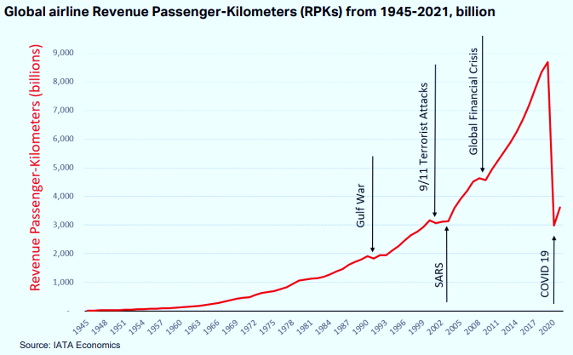
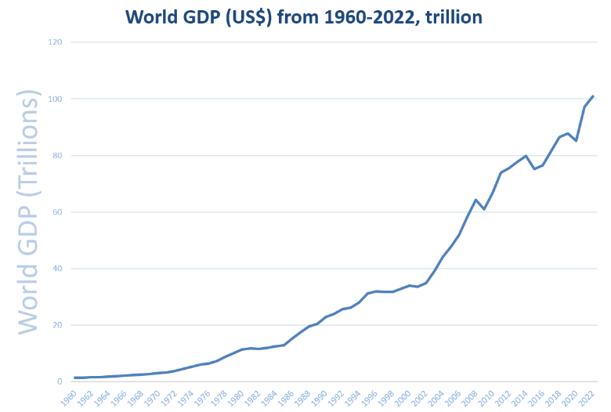
Growth of passenger travel closely related to GDP → further grow expected
Until 2019, international air travel grew over 20 times in 50 years
Until 2019, the World GDP grew over 64 times in 50 years
“Jet Age”
“Hub-and Spoke”
“Low-Cost Carriers & Decentralization
Source: World Bank
Future
As world GDP continuous to grow, the aviation market will grow. Aviation will become accessible for more people, especially in Asia and Africa

Slide 6
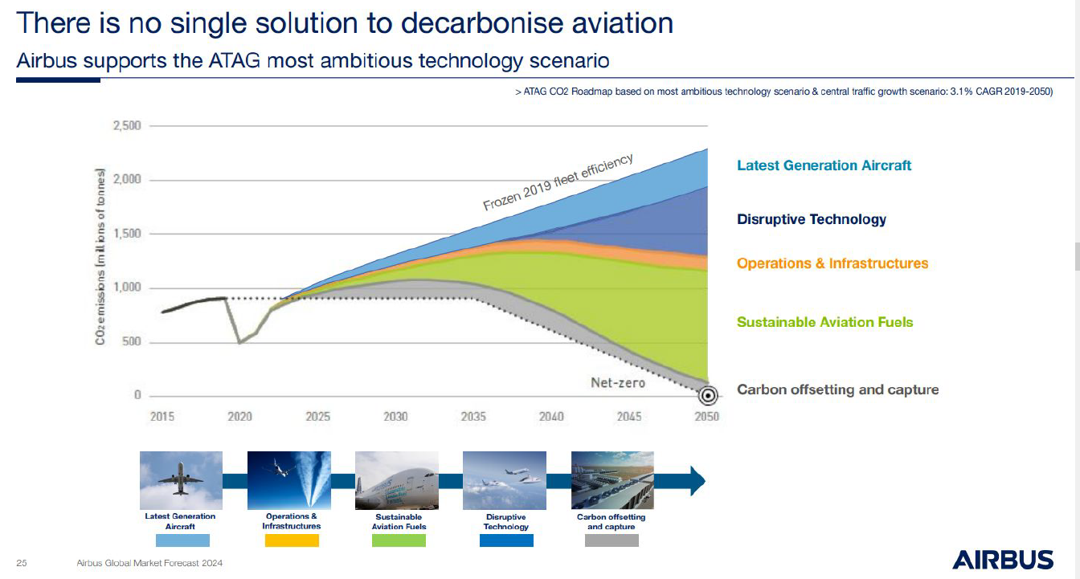
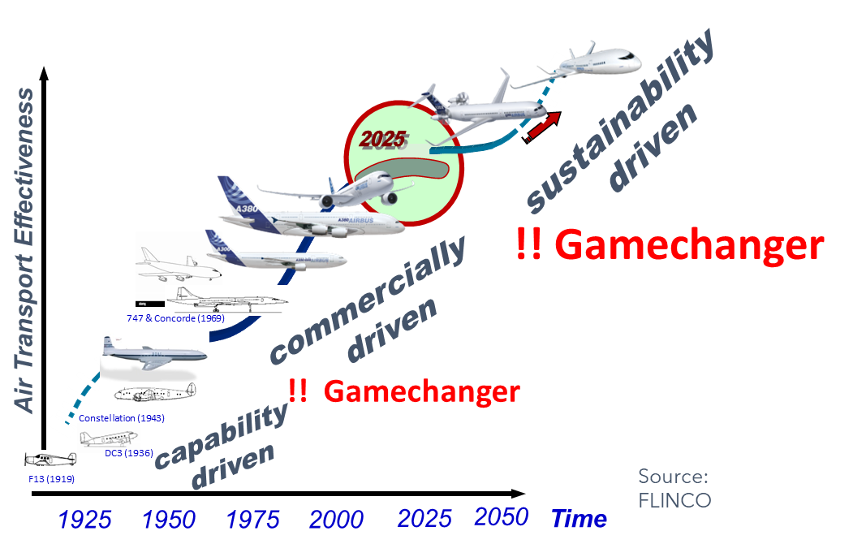
Transitions ahead
The drive for sustainable air transport create a drive for new designs and new technology
But there is more: lack of skilled workers, growth outside of Europe, geo-political threats
And the “old” challenges: safety, availability, on time delivery, affordability did not disappear!

Slide 7
Content
Introduction
Overview of aerospace industry characteristics
Netherlands industry position
Market analysis – large commercial
NL opportunities & threats, strengths & weaknesses
Next steps

Slide 8
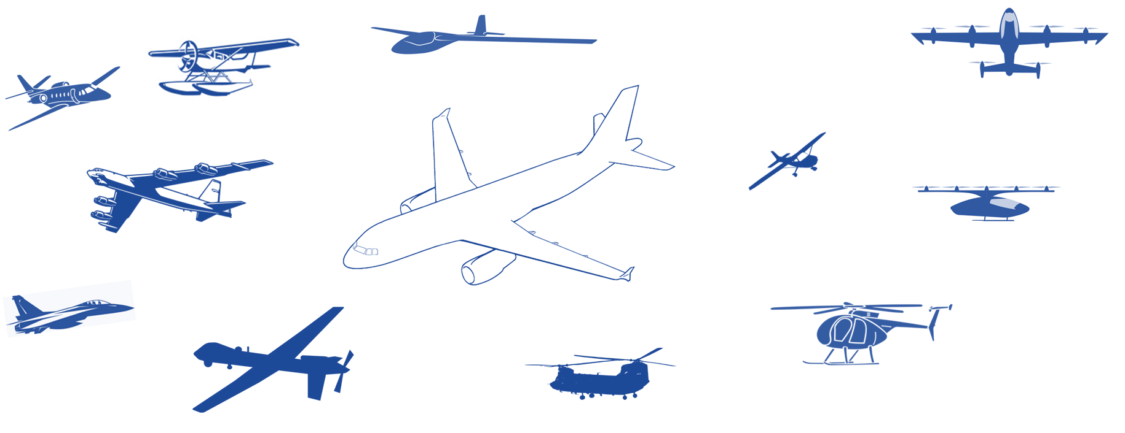
Overview of aerospace industry characteristics
High level of specialisation
Long program life (50+, if successful)
High quality and certification standards
Complex supply chains
Different market segments with different needs (aircraft performance, production rates, life cycle)

Slide 9


Commercial airline segment can be divided in four subsegments
Narrow-body airliners
Wide-body airliners
Regional Aircraft
Commuter Aircraft
Cross section
Purpose
Short to medium-haul routes
Long-haul flights, premium service
Short-haul, small airport connection
Short-haul, point-to-point
Key
Features
Capacity: 100 – 250 passengers
Range: 5000 – 10.000 km
Comfort: Standard with narrow cabins.
Reliability: Quick turnaround for frequent flights.
Performance: Suitable for various airports.
Cargo capacity: Limited.
Capacity: 200 – 500+ passengers
Range: 10.000+ km
Comfort: A lot of space with premium amenities.
Reliability: Designed for long-duration missions.
Performance: High altitude and long-range capabilities.
Cargo capacity: Spacious holds for large cargo volumes.
Capacity: fewer than 100 passengers
Range: 2000 – 4000 km
Comfort: Standard with narrow cabins.
Reliability: Quick turnaround for frequent flights.
Performance: Suitable for regional airports and shorter runways.
Cargo capacity: Limited.
Capacity: fewer than 50 passengers
Range: 1000-2000 km
Comfort: Standard with narrow cabins.
Reliability: frequent short flights.
Performance: Take-off and landing for small airports.
Cargo capacity: Minimal.
Market dominated by
Boeing 737 and Airbus A320 families
Boeing 777, Boeing 787, Airbus 330 and Airbus A350
Bombardier CRJ, Embraer E-Jets and ATR turboprops
Beechcraft, Cessna and Pilatus

Slide 10





The aircraft integrator develops the aircraft, and its enabling processes, together with suppliers
Aircraft development
Phased design process
Phased approach to manage risks and align development processes with decision making by stakeholders.
Design to meet all relevant requirements
  Operations, maintenance, production, support, etc.
  Set up of the supply chain
  Safety & Certification with relevant authorities
Technology development
Develop technologies to required maturity, including integration, manufacturing, operational and certification maturity.
Production system
Customer Support
Development and Industrialization
Development for a specific aircraft
Initial production of prototypes
Ramp up to series production
Ensuring Operational Readiness & Continued Airworthiness:
Operational Suitability & Continued Airworthiness processes assure trouble-free operations – from start until end of life
Production System Development:
Master schedule definition
Production system specification
Process development and qualification
Maintainable aircraft:
Aircraft need to be maintainable to effectively execute the maintenance program, ensuring safe and cost-effective flight operations.
Series Production Readiness:
Production system is mature enough to produce the aircraft at the required rate with consistent quality and reliability, and within the budgeted cost.
Required Resources:
Enabling operators to execute the maintenance program, requires skilled and trainee staff, tools, manuals and customer support channels for specific issues.

Slide 11
How is an aircraft designed and certified?
Business Opportunity Study
Feasibility Study
Project Definition
Operational Validation
Full Scale Development
Program phasing & milestones
Business Initiative
BOR
Business Opportunity Review
PRR
Project
Requirements Review
CPR
Critical Project Review
FDR
Final Design Review
Customers and Authorities
Program
proceed
Program
launch
Program plans/contracts
established
Airworthiness Certification
Entry into Service
Program Management
Preliminary BC
Final BC
Cost guarantees
Marketing & Sales
Operational
Concept
Customer interest
Offers
Launch customers
Sales
Market
Requirements
Performance Guarantees
Design
A/C Concept
A/C level
Certif
Base
Test & Certification
Sustaining
Technology development
Technology
validation
Engine & main systems Guarantees
Production
Production Concept
Production plan
Series Production
Production & Support requirements
Maintainability data
Customer Support
Support Concept
Contract specs
OPS Support
Procurement
Acquisition
Concept
LOI strategic suppliers
Contract suppliers
Contract management
RFI’s
Supplier LOI’s
strategic supplier contracts
RFP’s
11

Slide 12
Aircraft production: Final Assembly Line with extensive supply chain
Aircraft Integrator
Has integration role for the design, certification and final assembly line
Tier 1 suppliers
Major suppliers for Major Assemblies and systems, can be part of Integrator
Tier 2
Smaller companies supplying parts and components
Tier 3
Material and standard part production
Machine and technology suppliers
Provide necessary technology developments

Slide 13
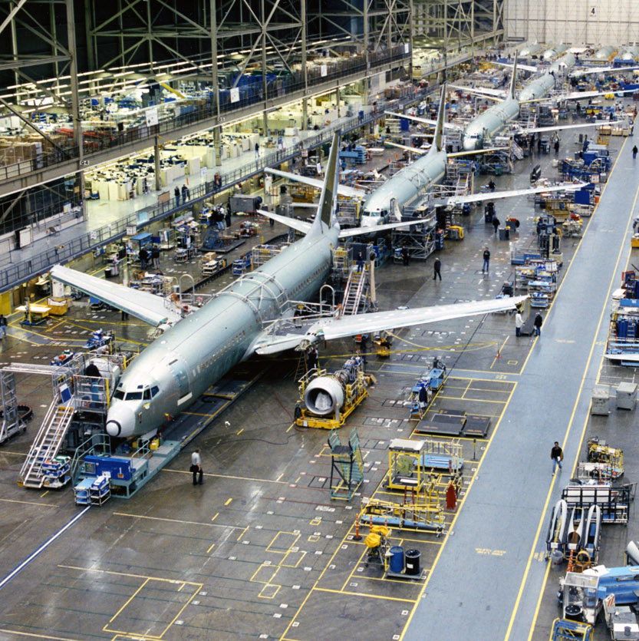
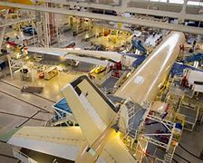
Aircraft production: High rate line production
Boeing moving assembly line
Aircraft line production
Goals:
High-rate production
Low cost
Final assembly lines
Airbus A320:
8 lines (Hamburg, Toulouse, Tianjin, Mobile)
60 > 75 aircraft/month
Boeing 737
3 lines (Renton)
35 >> 70 aircraft/month
Airbus A350
1 line (Toulouse)
6 > 11 aircraft/month
Boeing 777
1 line (Everett)
3 aircraft/month
Airbus A350 final assembly
Sources: Boeing assembly line, https://www.airlinereporter.com/2013/07/inside-boeings-737-renton-factory-and-the-successful-next-gen/ (download: 18-3-2024)
Airbus A340 assembly, https://www.modernairliners.com/airbus-a340 , (download: 18-3-2024)

Slide 14
Content
Introduction
Overview of aerospace industry characteristics
Netherlands industry position
Market analysis – large commercial
NL opportunities & threats, strengths & weaknesses
Next steps

Slide 15
NL industry capabilities and capacity
NL Industrial focus: MRO largest segment; Make 2nd; Airports & Services 3rd
Make (Co-design, Build & Support solutions)
Work packages for systems, parts
Enabling tools/machines and services
MRO services and end of life
solutions
Work packages on airframe, engines and components
Enabling tools/machines and services
Products and services for zero-emission Airports/(energy) infrastructure
Products and services for zero-emission Airline operations
Lightweight Structures & Materials
Circular Interior, Biobased materials
Smart grids
Integratie met andere modaliteiten
IT oplossingen voor efficiente flight operations
Sustainable systems: electrical (EWIS, e-compressors), thermal management,
LH2 (fuel management, fuel cells), engines on eSAF
Smart buildings. runways
Collaborative Decision Making
Novel concepts aircraft (LH2, elektrical, aerodynamics),
Operational testing of new technologies
Zero-emission ground ops & vehicles
Air Traffic Management optimisation
Enabling technology, expertise and methods, machines, tooling, automation solutions for development, production and MRO
Virtual en full scale testing & development facilities & environments
Enabling IT knowledge and solutions (AI, VR/AR, supply chain automation)
Contract research on all of the above

Slide 16
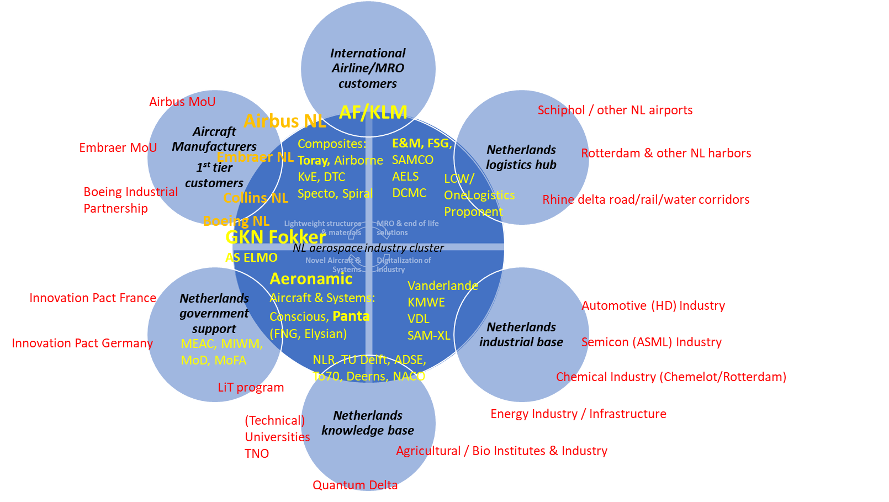
Rooted in the unique NL eco-system

Slide 17
Content
Introduction
Overview of aerospace industry characteristics
Netherlands industry position
Market analysis – large commercial
NL opportunities & threats, strengths & weaknesses
Next steps

Slide 18
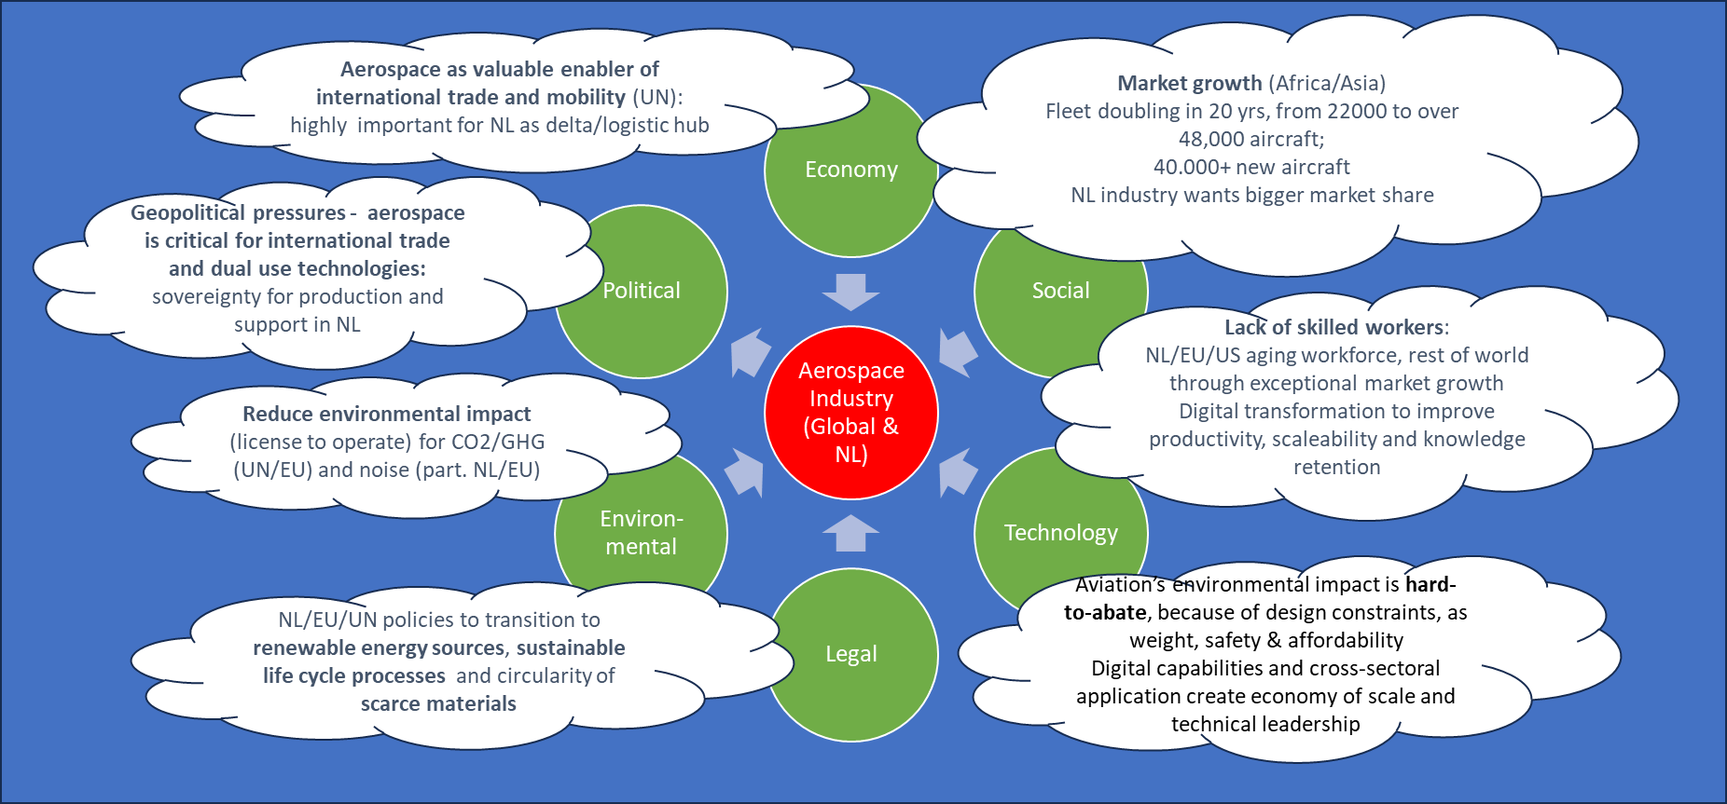
Market - PESTLE analysis

Slide 19
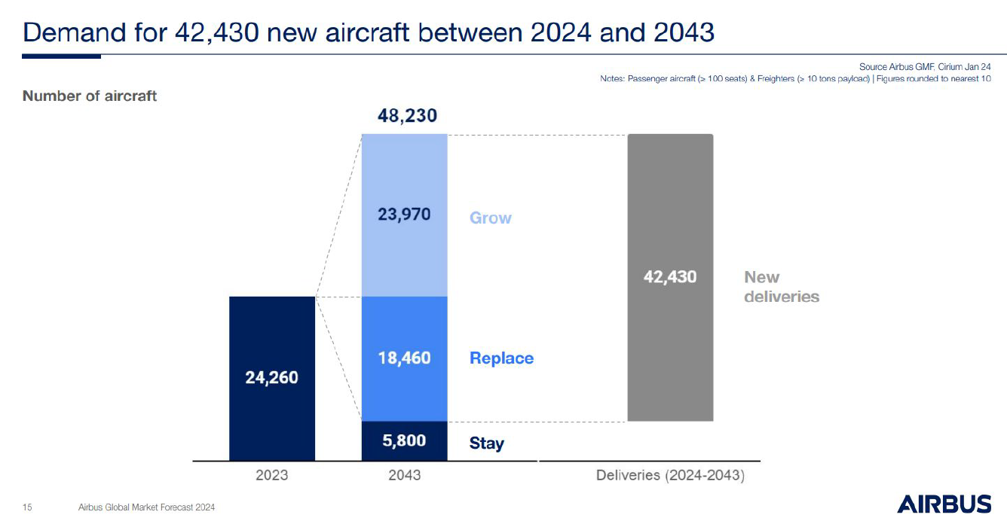
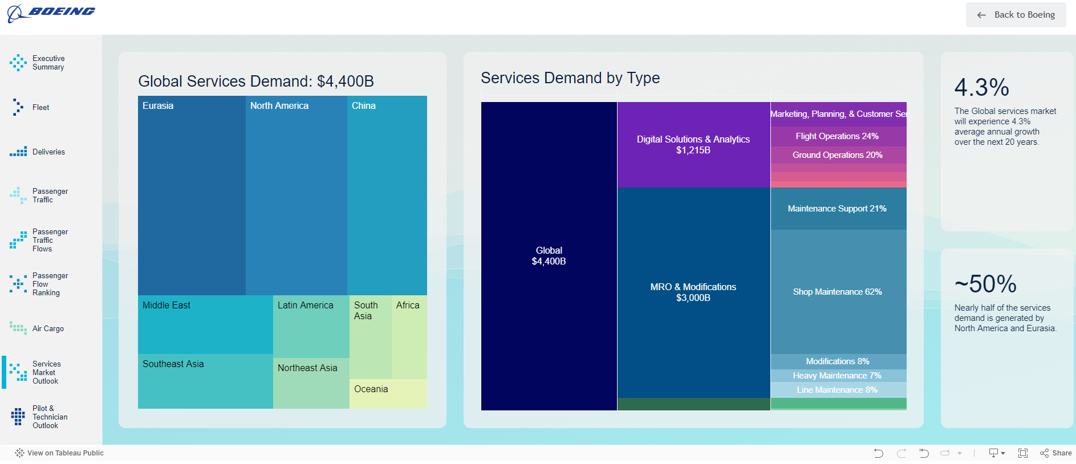
Market analysis - new aircraft production – growing fleets (and MRO)

Slide 20
Aircraft Development - Current & Future programs
Production & MRO for current design aircraft
Transition to new designs and upgraded aircraft
Development & Production Programs run for several decades
Technology and related suppliers are selected during development
Supply chain positions in a program are therefore only open at the start and often last for the full life cycle
Offering best in class technology is not sufficient to be selected, also other factors play a role (price, life cycle cost and value, quality and industrial robustness, value adding services, and risk)
Only lower value parts and subcontracts come on the market more often, but face fierce competition

Slide 21
Content
Introduction
Overview of aerospace industry characteristics
Netherlands industry position
Market analysis – large commercial
NL opportunities & threats, strengths & weaknesses
Next steps

Slide 22
NL Market analysis - SWOT
NL Opportunities
  Market growth through replacements in US and Europe and growth in Asia, MEA and Africa
  Need for new solutions (due to transitions)
  Sustainable aircraft
  Sustainable production, MRO and end of life processes
  Lack of skilled workers
  Geopolitical shifts and the effect on supply chains (e.g. for critical materials)
NL Strengths
MRO capability (airframe, engine and components) for large commercial and defense
(Co-)Development and production of light weight structures, electrical systems for all segments
Knowledge on hydrogen and thermal management systems and on circular materials development and end of life solutions
Development capabilities for novel designs of electrical and hydrogen/hybrid propulsion aircraft
NL Threats
  Uncertainties in rulemaking and policies
  Geo-political threats and troubles
  Insufficient technology readiness (airworthiness, rate readiness, affordability)
  OEMs (Airbus, Boeing, Embraer), OESs (RR, PW, GE, Collins, Safran, etc.) want to leverage their IP positions to get more business out of the after market
NL Weaknesses
  Small internal market
  Risk avoiding mentality and lack of venture capital for higher risk programs
  Lack of skilled workers
  Limited power for industry policies
  Segmented sector of specialists who, yet, do not offer a single product or service

Slide 23
Content
Introduction
Overview of aerospace industry characteristics
Netherlands industry position
Market analysis – large commercial
NL opportunities & threats, strengths & weaknesses
Next steps

Slide 24
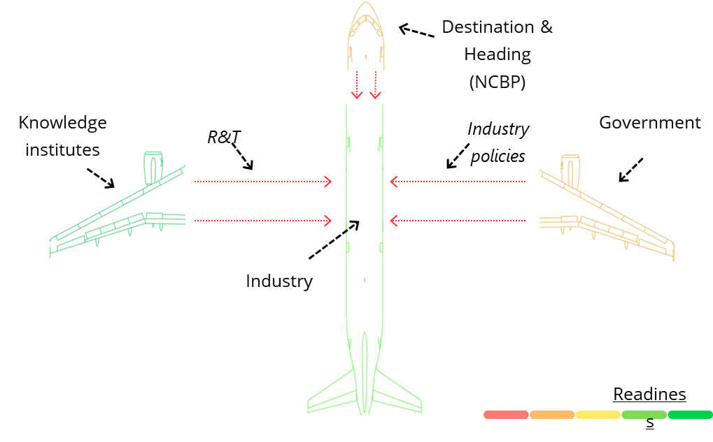
To create scale-able and exportable services, we must develop
New business models
  Covering MRO jobs and all related supporting activities
  Connecting MRO experience to (co)development
New cooperation models within NL and with OEMs and OESs
  To access data and new markets
  Leverage MoUs with Airbus, Embraer and Collins/RTX
New methods and tools
  Not only to reduce cost and dependance of skilled workers
  To increase productivity and exportability
New cooperation models for MRO (with educational institutes, Defense, with High Tech equipment industry, others)
  To create economy of scale for IT and other automation solutions
  To learn faster, reduce the effort to get through the valley of death
New competitive value propositions using the new industry policy of the government and make our needs known – concrete and specific
  Technology Readiness is step 1 - Business Readiness is the goal
  To achieve Control Points - Based on competitive offerings

Slide 25
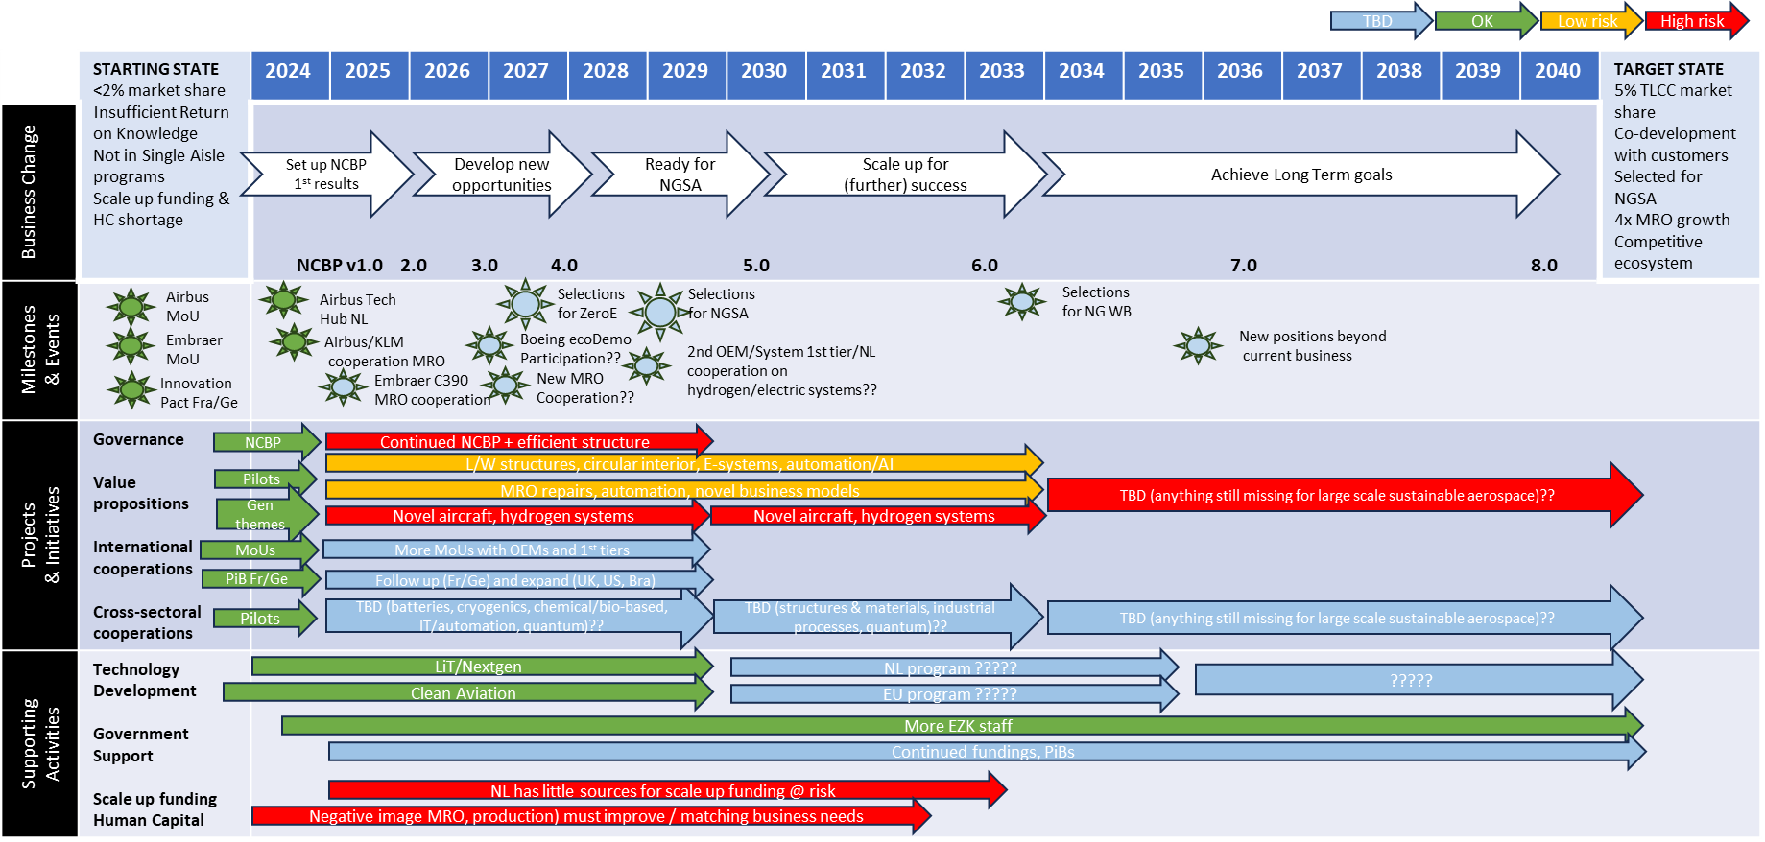
Roadmap 2024-2040

Slide 26
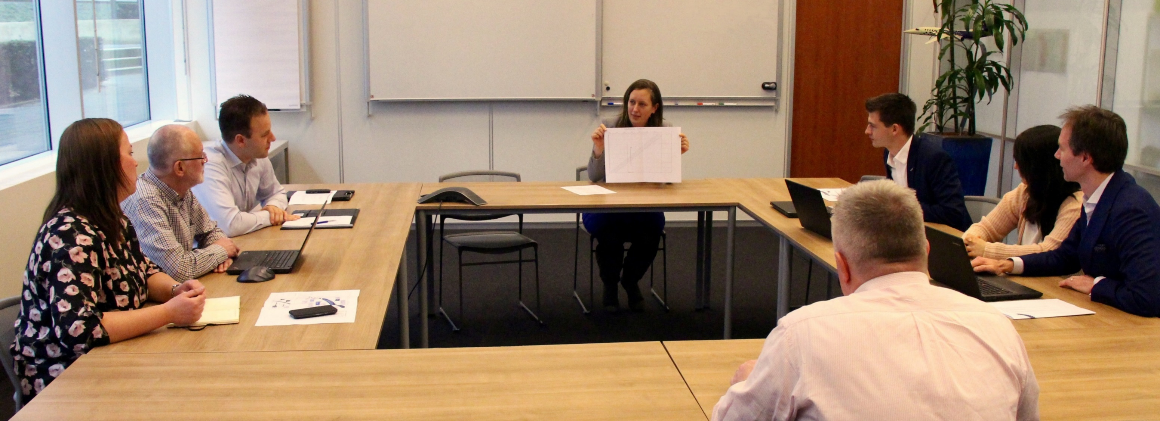

Contact details
For more than 25 years, we make it work
EXPERTS
IMPROVEMENTS
SOLUTIONS
INNOVATIONS
Visit us at:
www.adse.eu
Address: Planeetbaan 4
2132 HZ Hoofddorp
The Netherlands
Telephone: 0031 (0) 23 554 2255
E-mail: info@adse.eu

