Slide 1

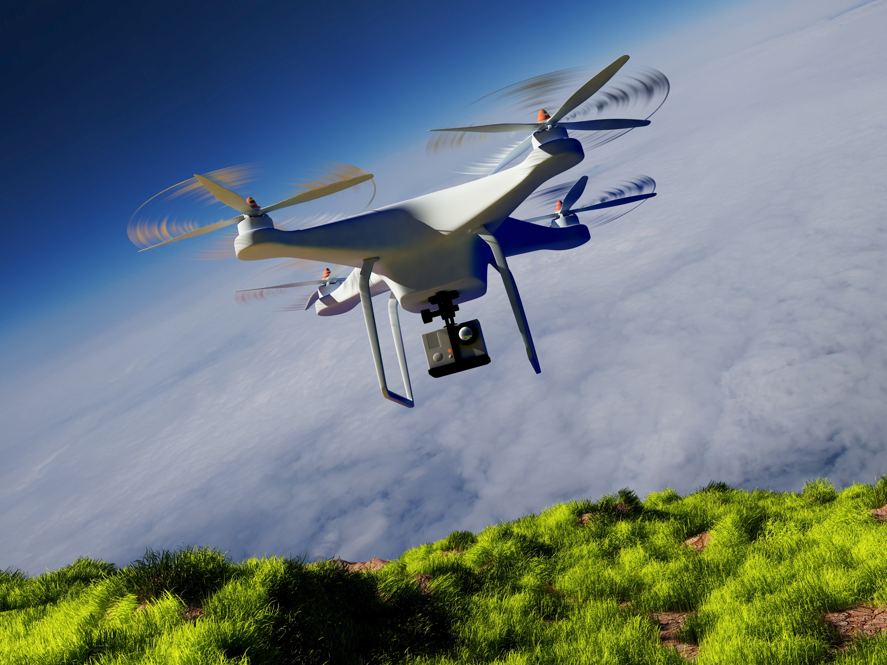
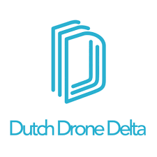
Dutch Drone Delta:
Connecting innovation for safe drone integration

Slide 2


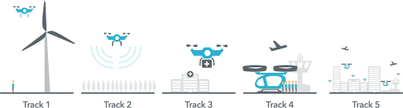




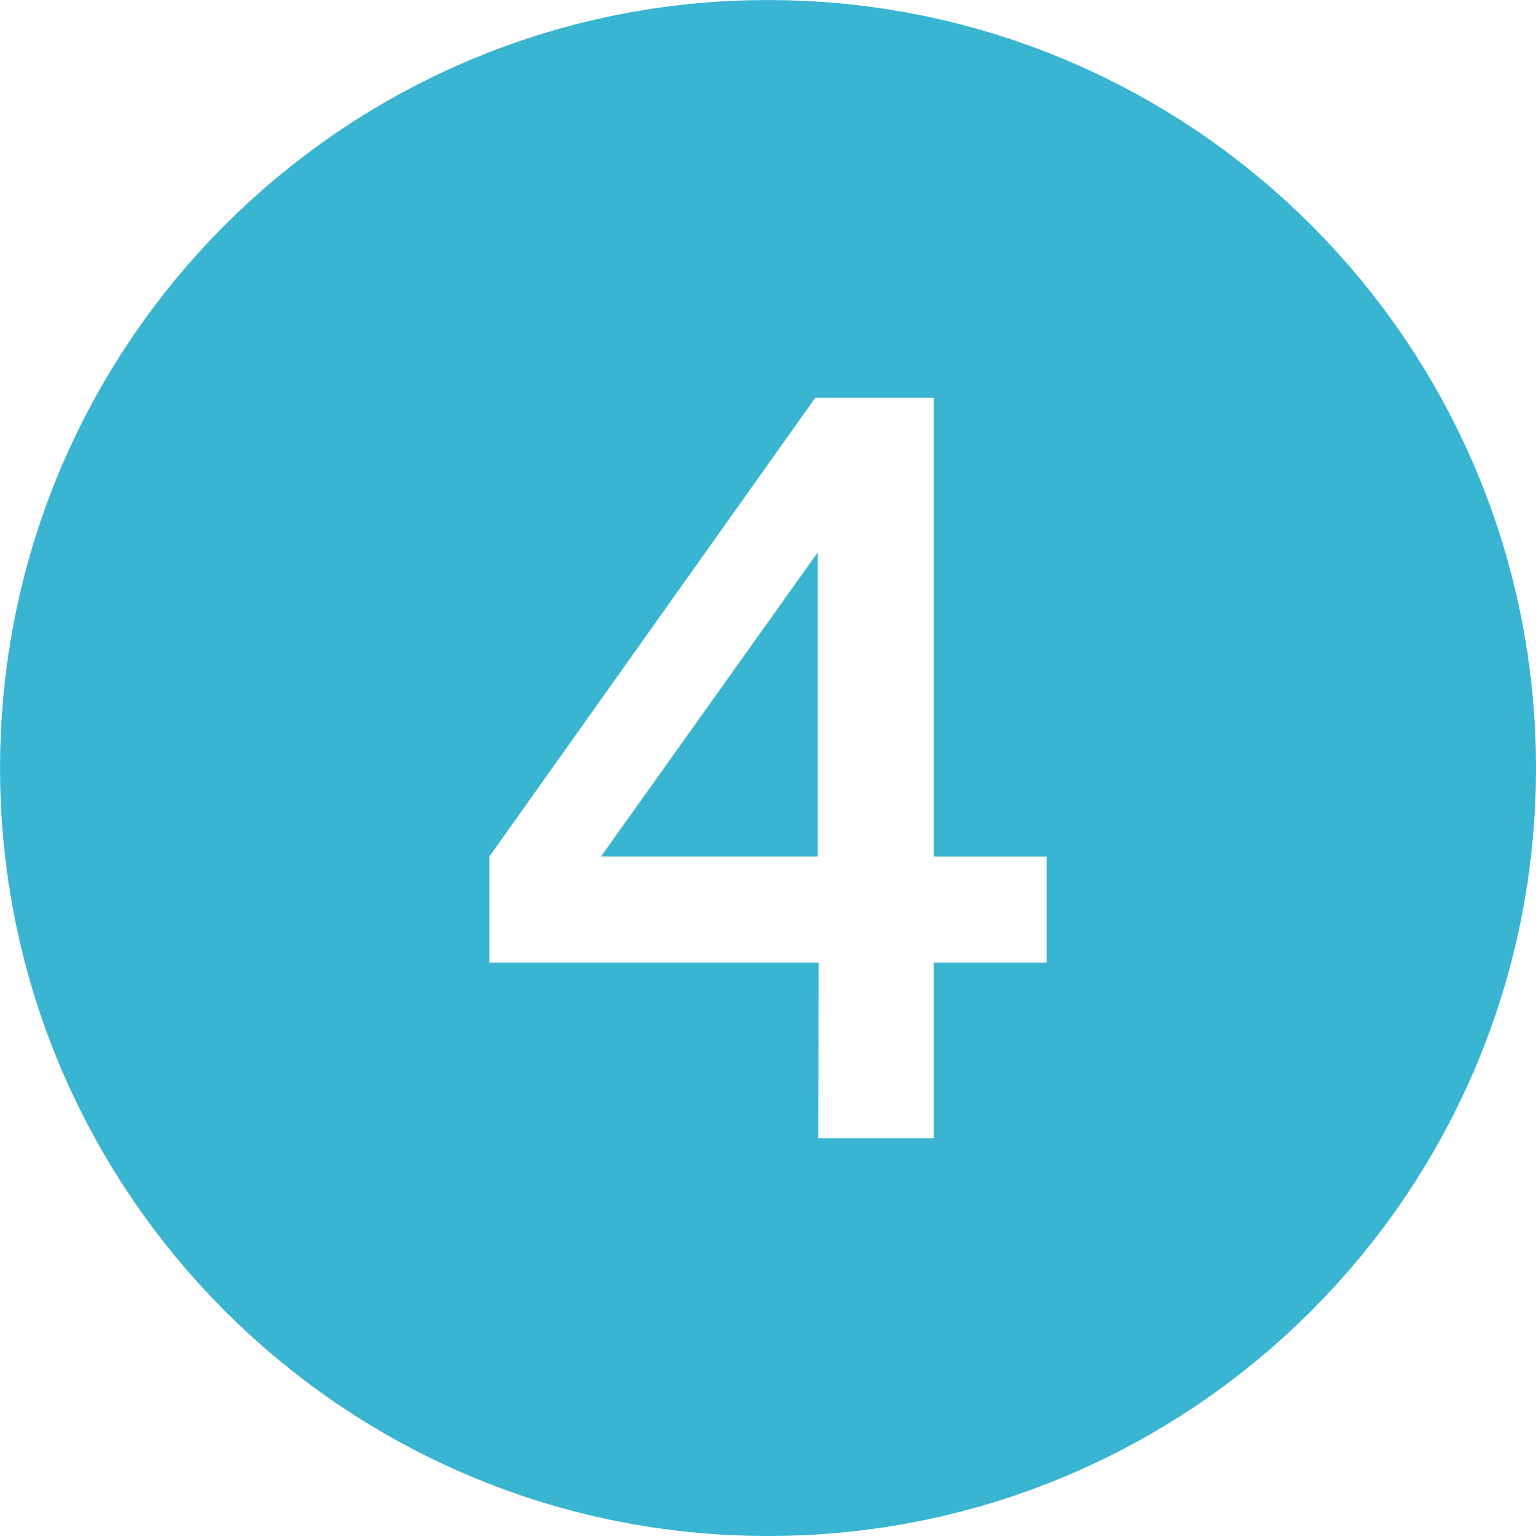


Dutch Drone Delta
The national public-private ecosystem accelerating unmanned aviation and UAM to deliver societal and economic value.
Our mission
Focus tracks
We connect industry, government and knowledge partners to co-create impactful drone solutions, positioning the Netherlands as a frontrunner in Urban Air Mobility.
Our approach
Co-create real-world use cases & pilots with societal and economic impact
Building trust & acceptance with citizens, policymakers & regulators
Connecting ecosystems & regions, fostering national and EU collaboration
Societal value & public acceptance
Autonomous long-distance flights (BVLOS)
Safe integration of manned & unmanned traffic
Drone delivery (medical, logistics, inspection)
Our ecosystem
Urban & regional air mobility for cargo and passengers
20+ partners, including Port of Rotterdam, Schiphol Airport, LVNL, Rijkswaterstaat, TU Delft, NLR, ROC van Amsterdam, ANWB, AirHub, Antea Group, KPN
info@dutchdronedelta.nl | www.dutchdronedelta.nl

Slide 3
Relevance of today’s topic
Dutch Drone Delta is the national ecosystem for drone innovation in the Netherlands, bringing together industry, government and knowledge institutes to accelerate the safe integration of drones into society.
Safe integration of drones also means addressing non cooperative drones.
For critical infrastructure such as airports and ports this requires:
Detection and monitoring technologies
Operational procedures and governance
Cooperation between civil and defense stakeholders
Integration with airspace management

Slide 4

What DDD contributes
Within the Dutch drone ecosystem DDD focuses on:
Connecting operators, technology providers, government and authorities
Developing and testing real world use cases
Sharing lessons learned from operational deployments
Supporting safe and scalable integration of drones in Dutch airspace
Examples include
collaborations with
partners such as:

