Slide 1
Drone detection is only the start
Smart and Secure Airports
March 2026

Slide 2




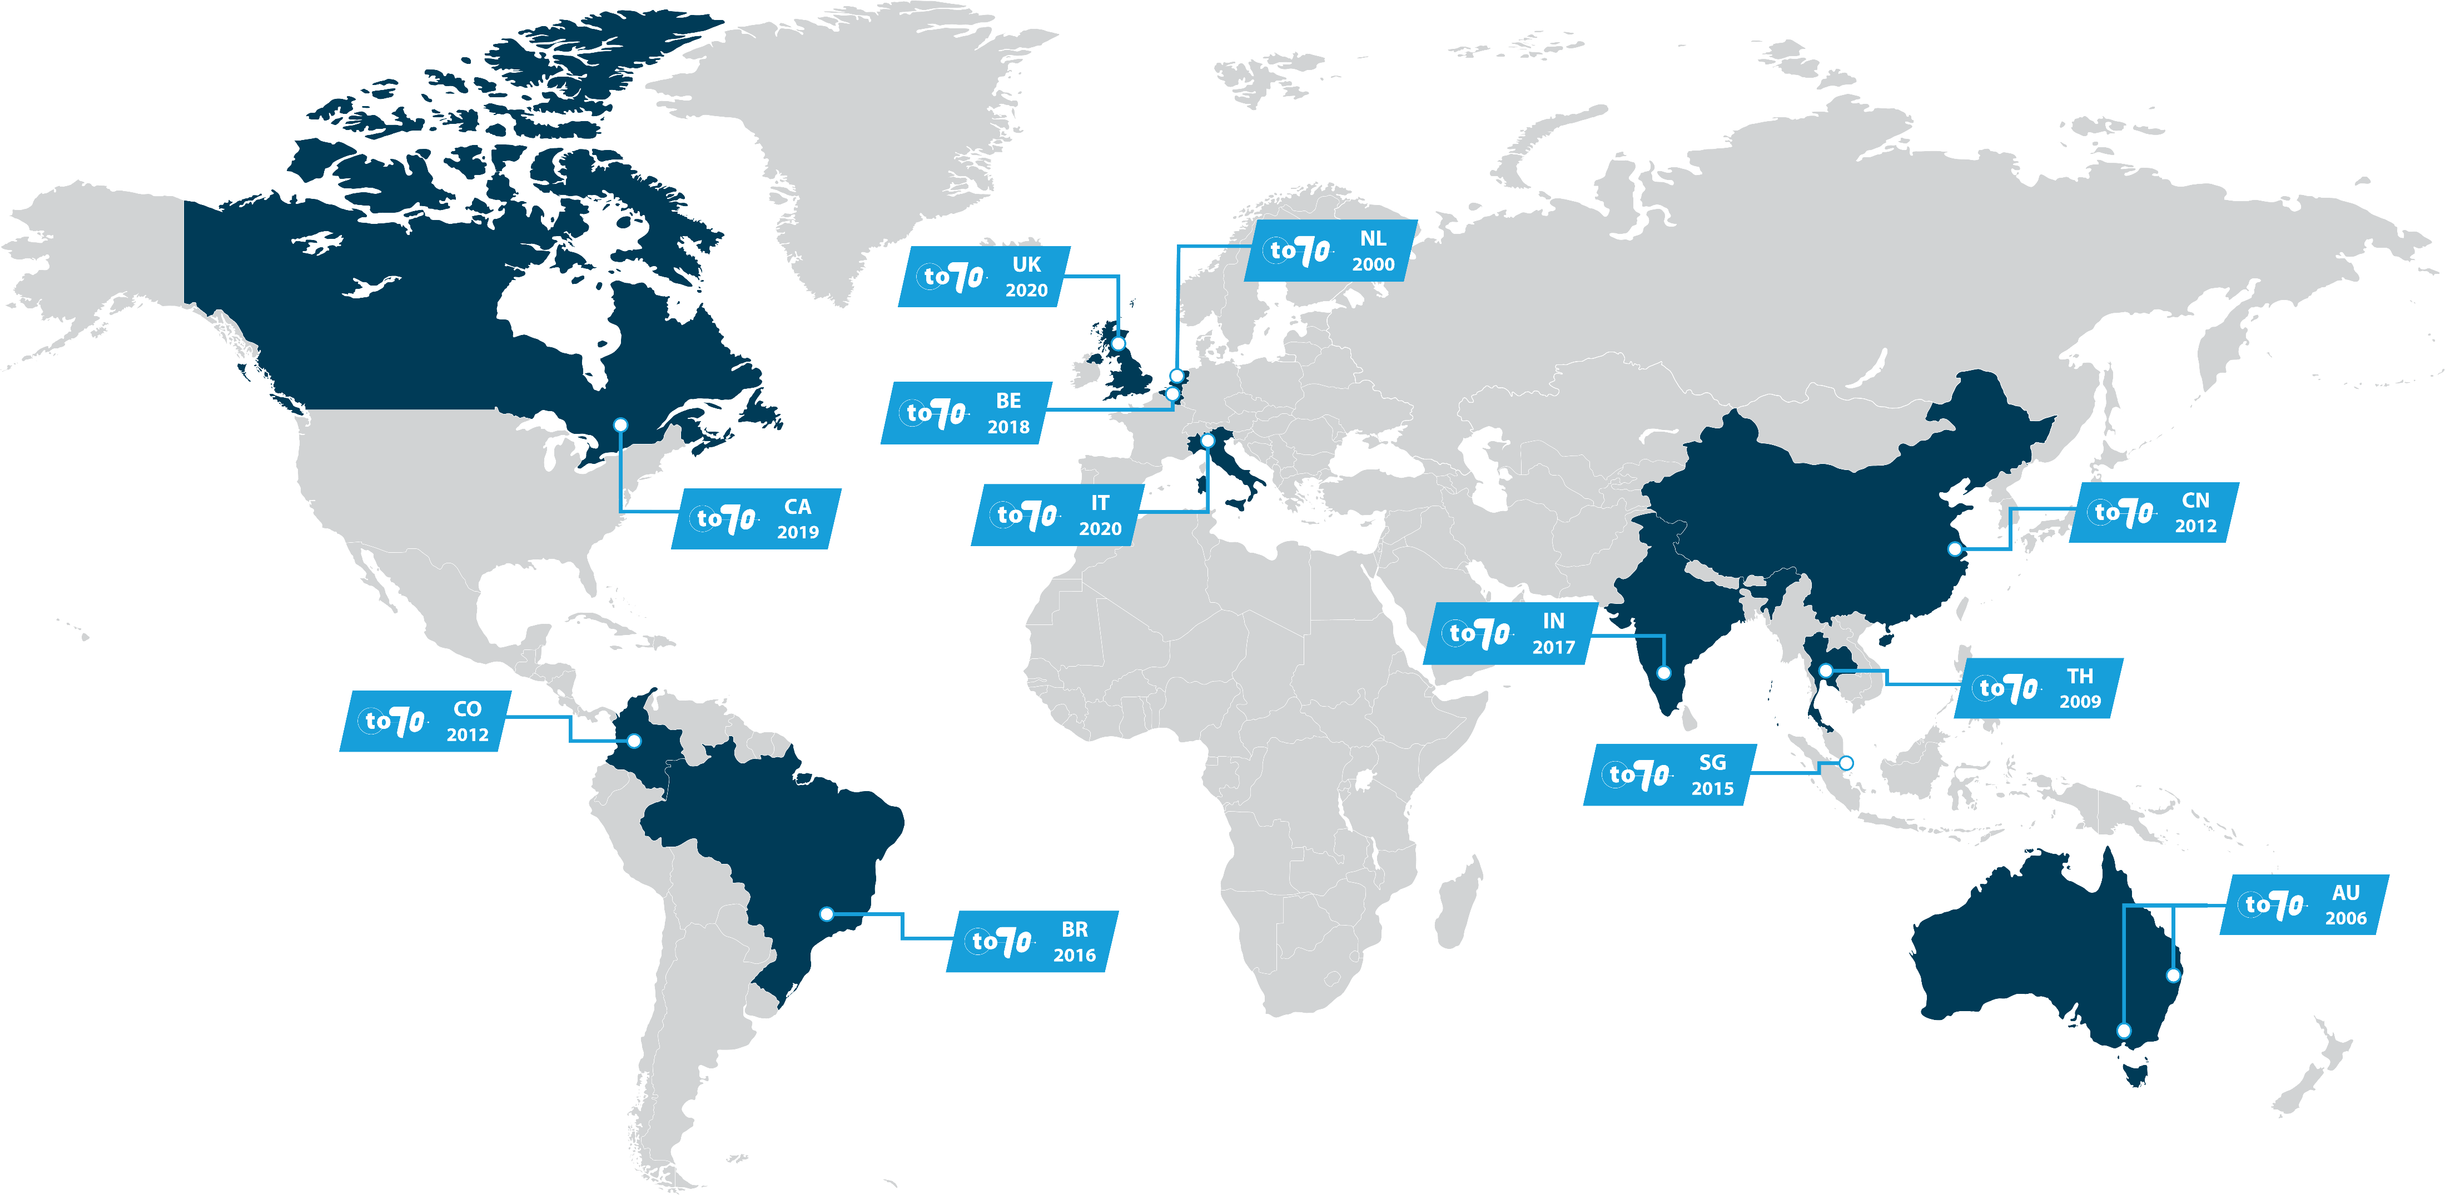
To70 Aviation
Our expertise
Founded in the Netherlands in 2000 and expanded to 13 offices across the globe, To70 is one of the world’s leading aviation consultancies.
To70 serves the aviation community by designing and optimising airport and airspace operations. Its mission is to help society and industry address the air transport challenges they face by delivering outstanding independent consultancy services.
Society’s growing demand for transport and mobility can be met in a safe, efficient, environmentally friendly, and economically viable manner. With a diverse team of experienced aviation consultants who possess first-hand knowledge across diverse range of aviation operations, To70 provides practical solutions and expert advice for its clients.
Air Traffic Management
Environment & Sustainability
Flight Procedure Design & Safety
Airport Planning & Operations
Think Global
Act Local
500+
Clients
13
International offices
4000+
Projects
25
Years of experience

Slide 3
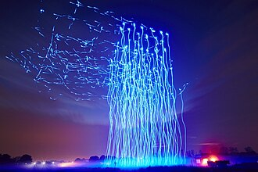
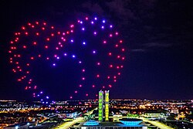
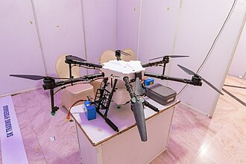
Source: https://creativecommons.org/licenses/by-sa/4.0/, unless otherwise reported

Slide 4
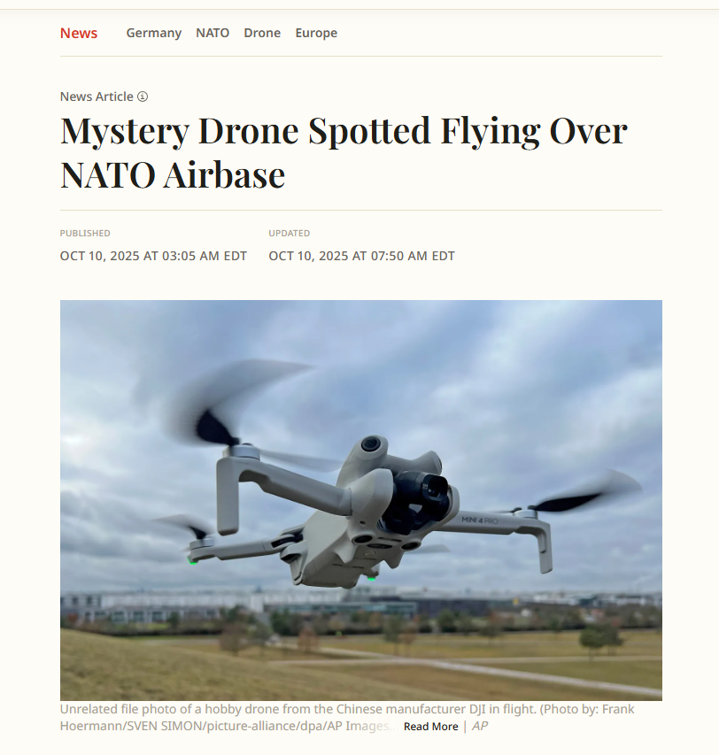
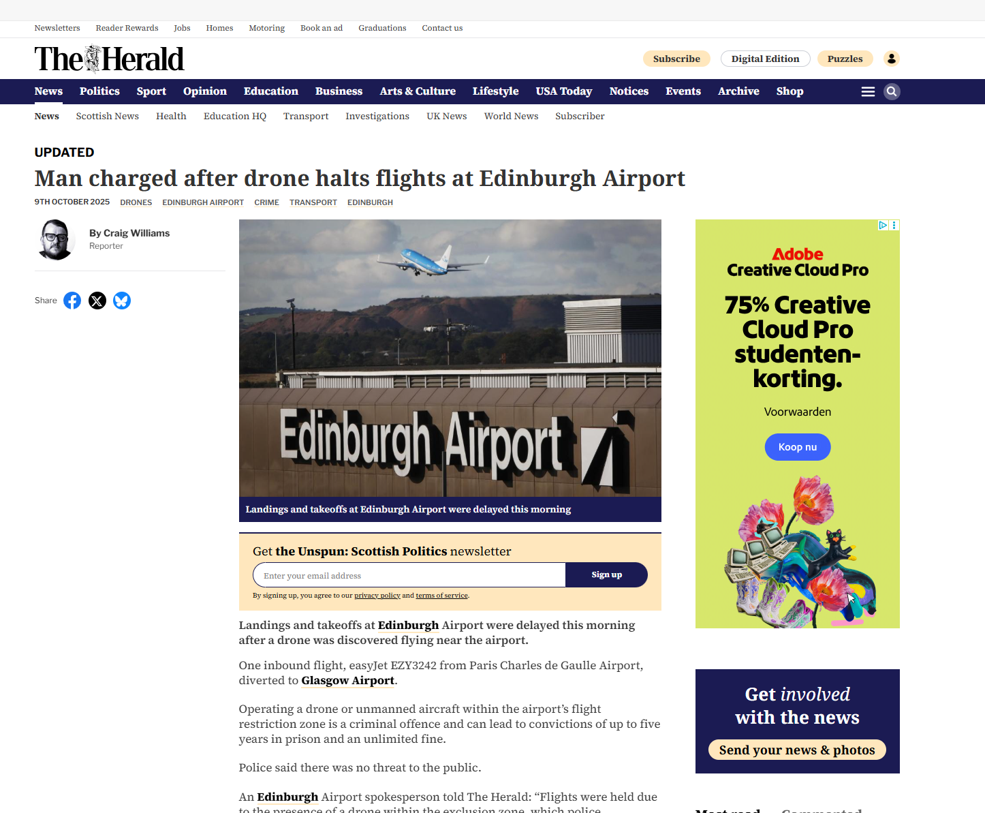
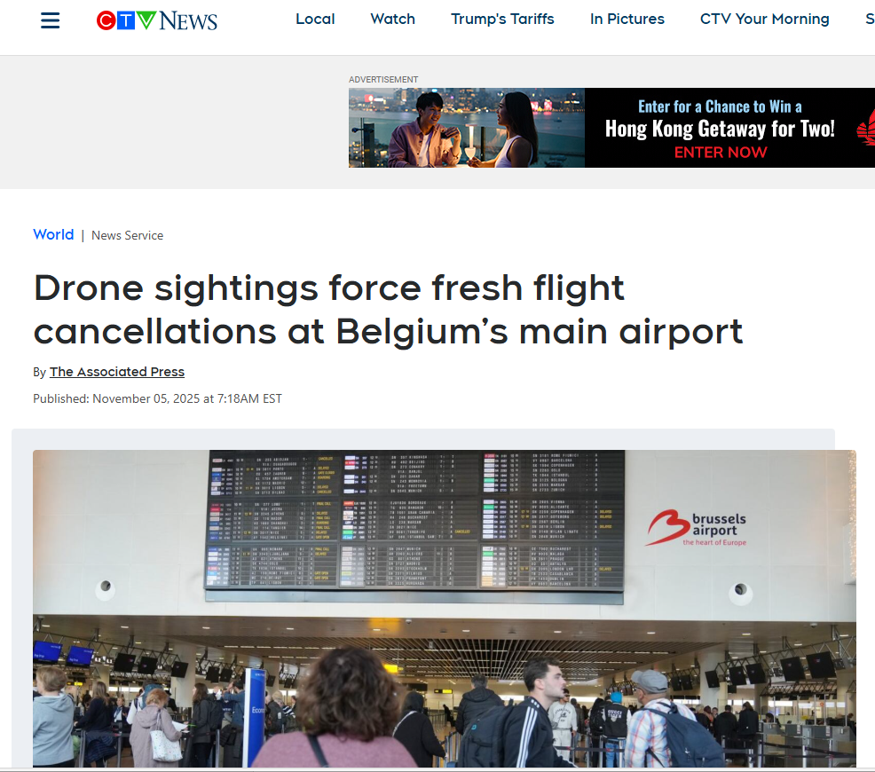
Recent incidents
Source: Newsweek, CTV News, The Herald

Slide 5
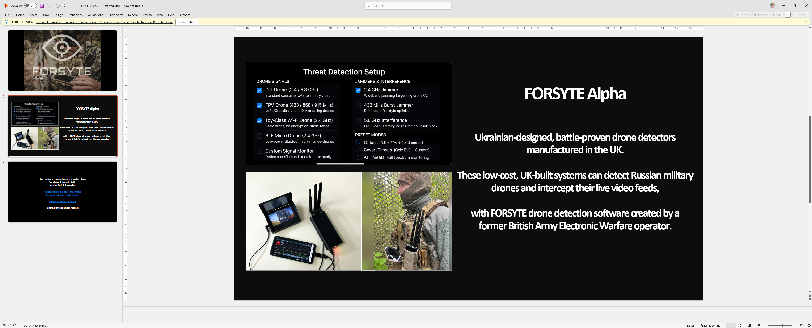
Mobile detection
Source: Cypher Tech Solutions Ltd
Notes:
FORSYTE Alpha

Slide 6
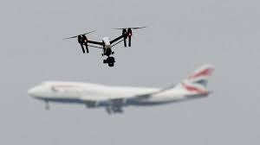
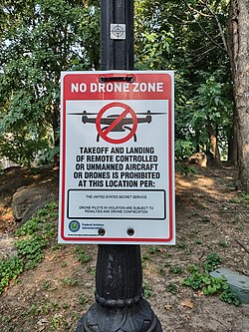
Non-cooperative
Three categories of non-cooperative drone users:
• Recreational negligence - the unknowing or uninformed;
• The too interested or curious (e.g. spotters), and
• The malicious.

Slide 7
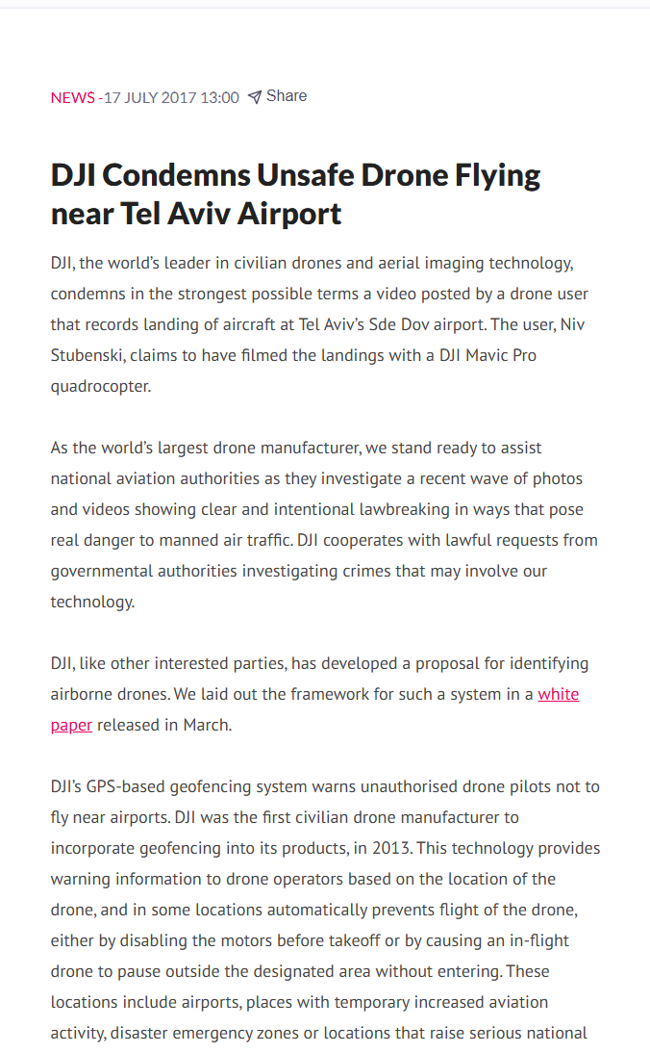
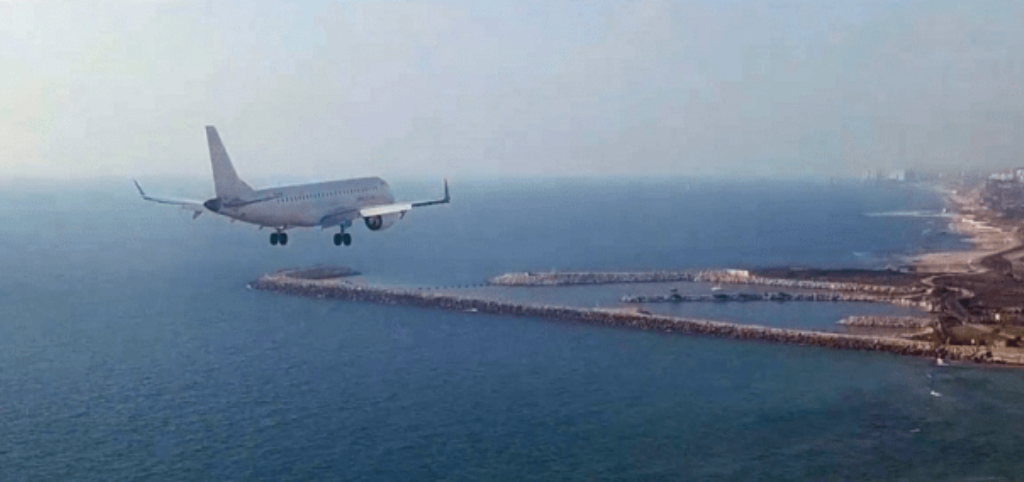
Sde Dov airport, 2017
Notes:
Sta’y Doe’v

Slide 8
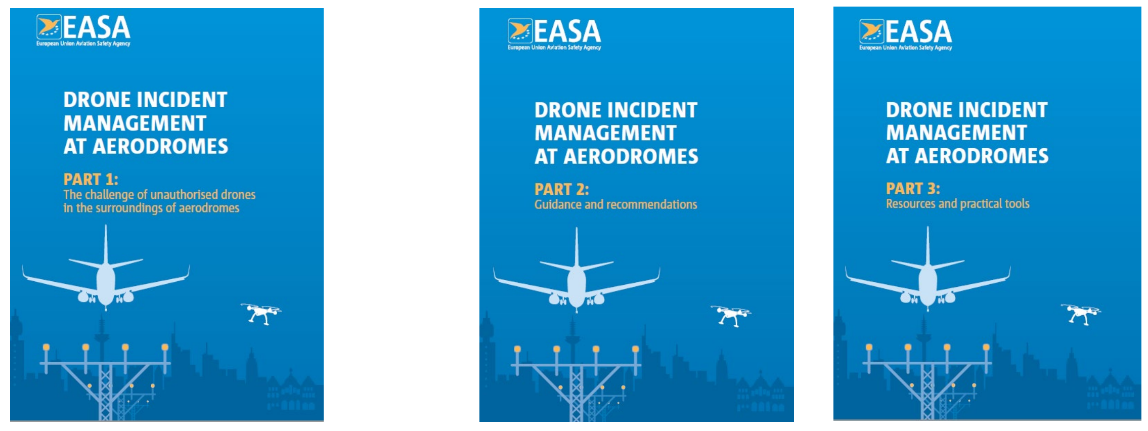
Useful guidance
Publicly available
Restricted access *
Source: EASA
* Requests to obtain the full manual should be sent to aerodromes@easa.europa.eu

Slide 9
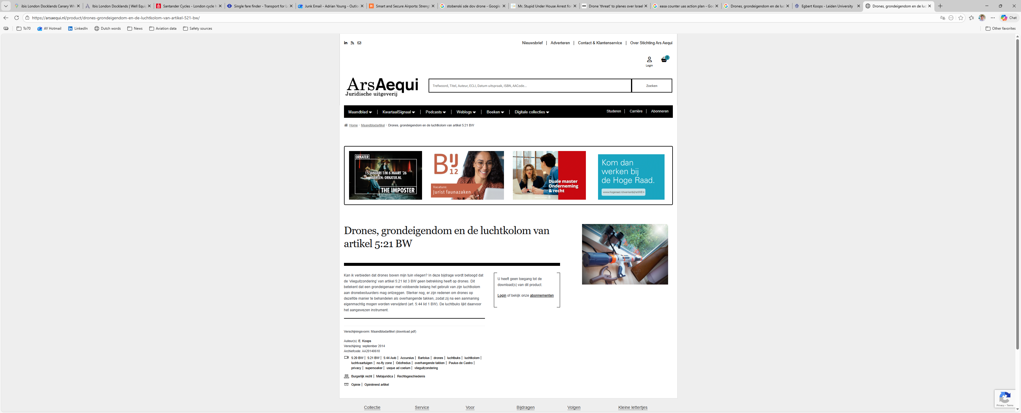
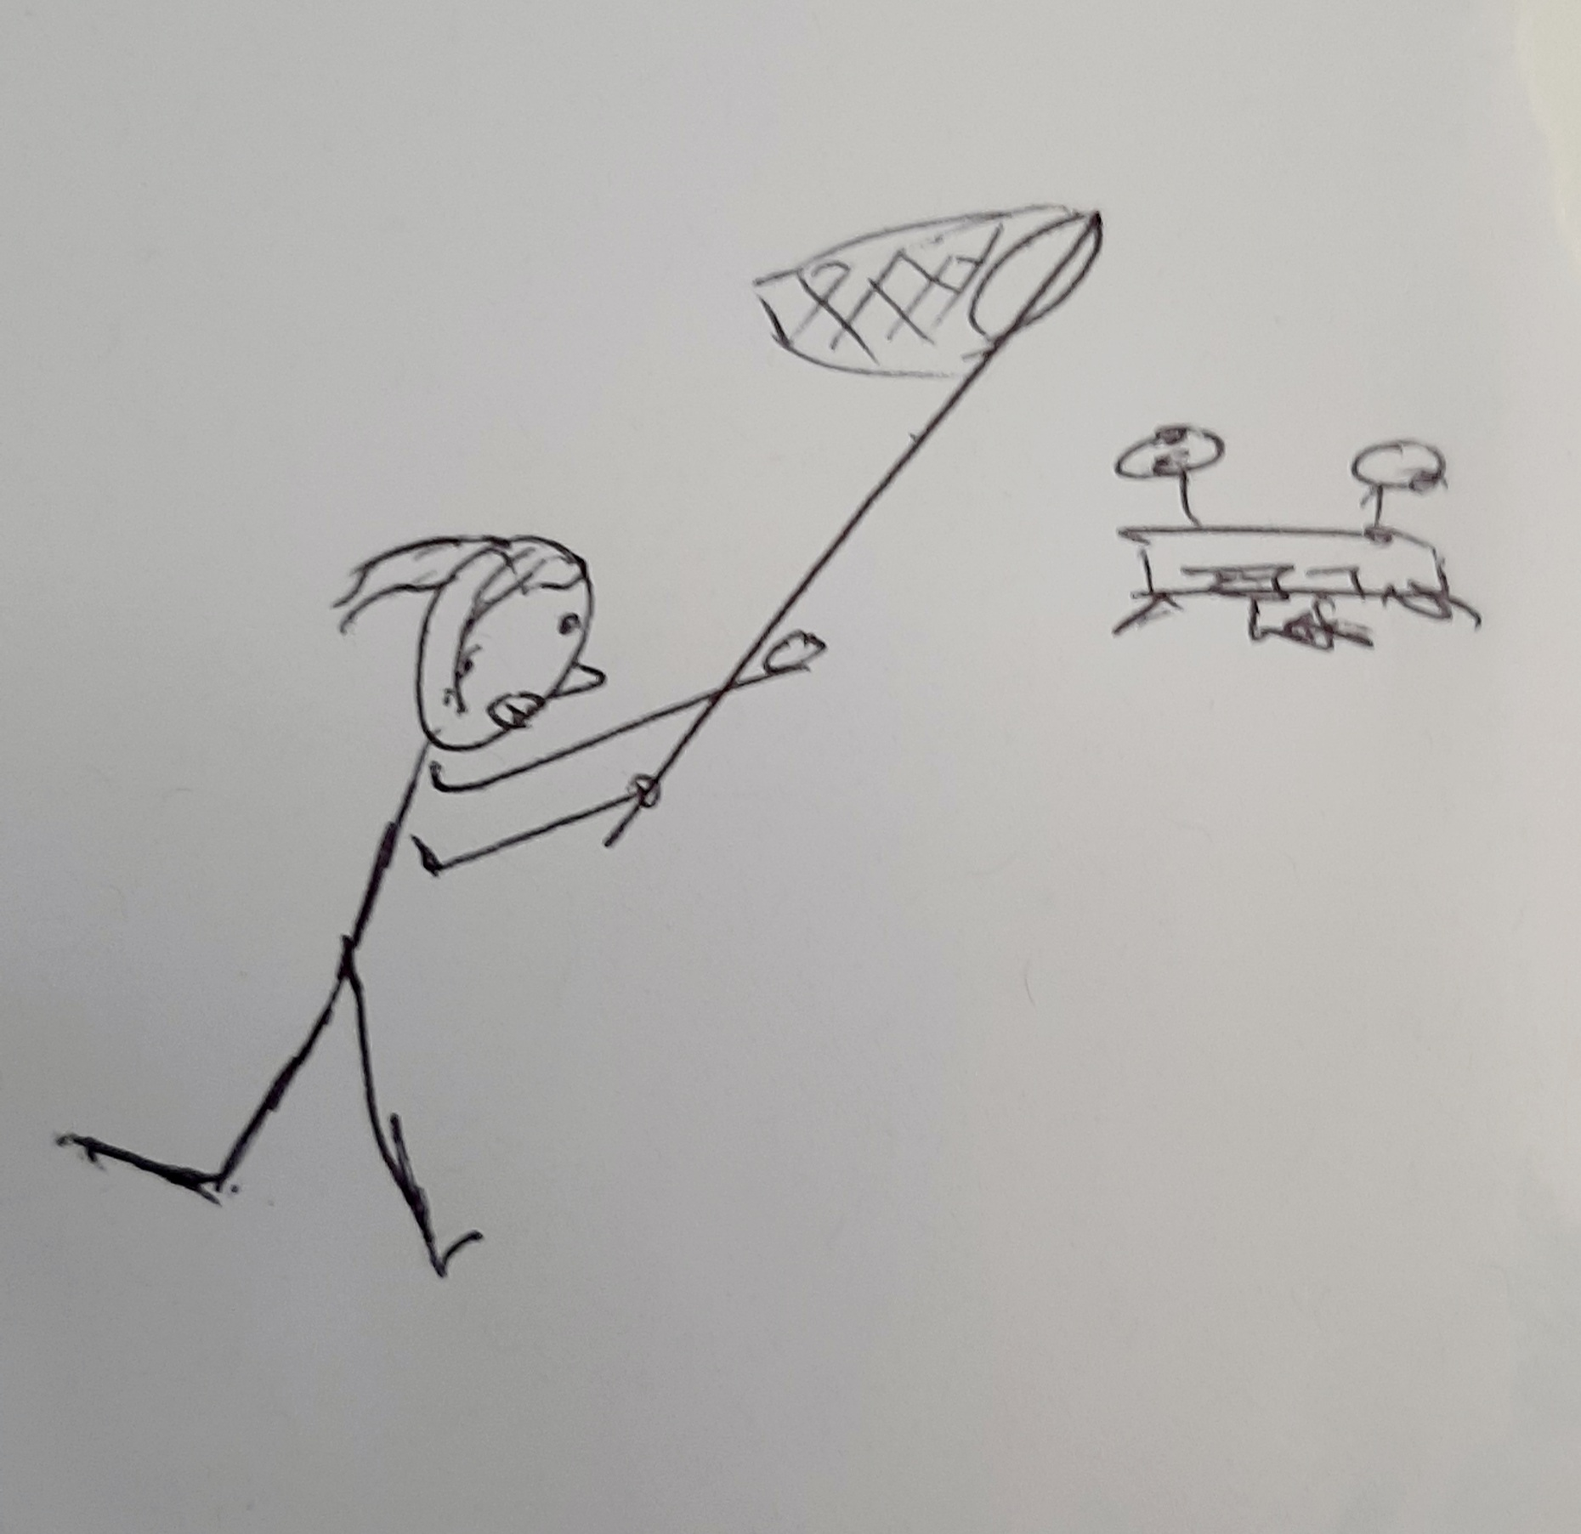
Can a drone be a tree?
Source: Ars Aequi, author

Slide 10
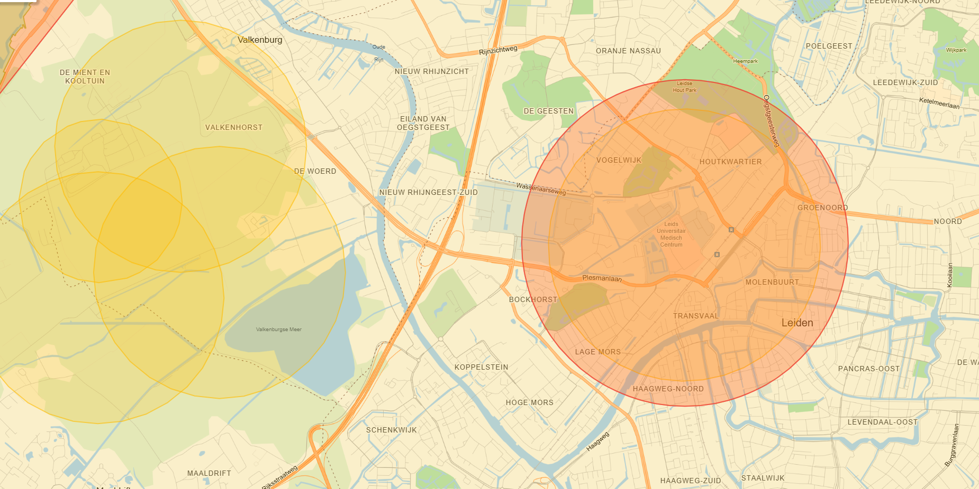
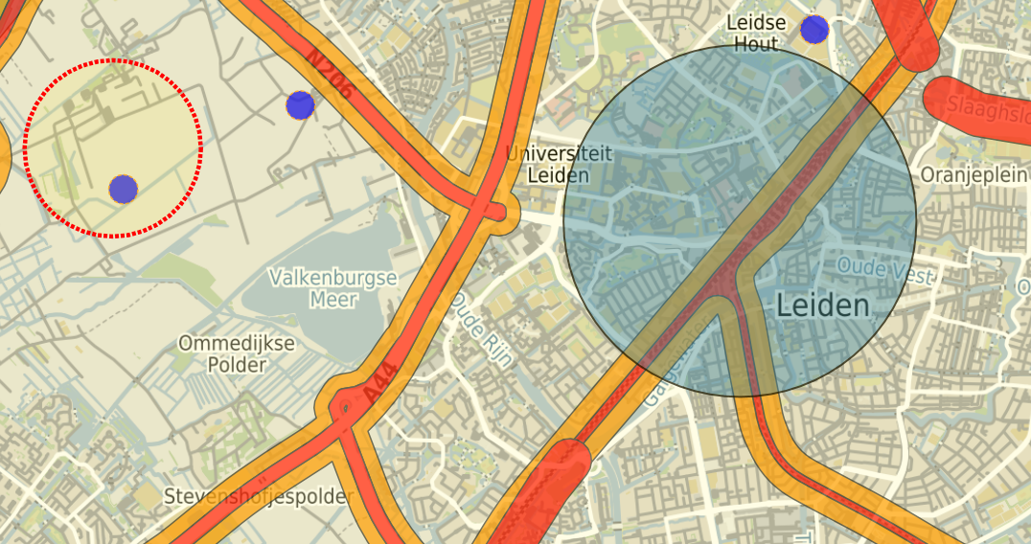
Aeronautical data
LVNL
Differences – at a glance:
Layout of restricted airspace for Drone Valley (ex-RNAS Valkenburg) differs between the two.
No vital infrastructure shown on LVNL-chart.
Radius of restricted airspace for heliport at LUMC is not the same
(See my house – red dot).
AERET
Source: LVNL, aeret

Slide 11
Bangkok, Bengaluru, Brisbane, Brussels, Edinburgh, Geneva, Medellín, Melbourne, Milan, Munich, São Paulo, Singapore, Shanghai, The Hague, Toronto.

